Slide 1
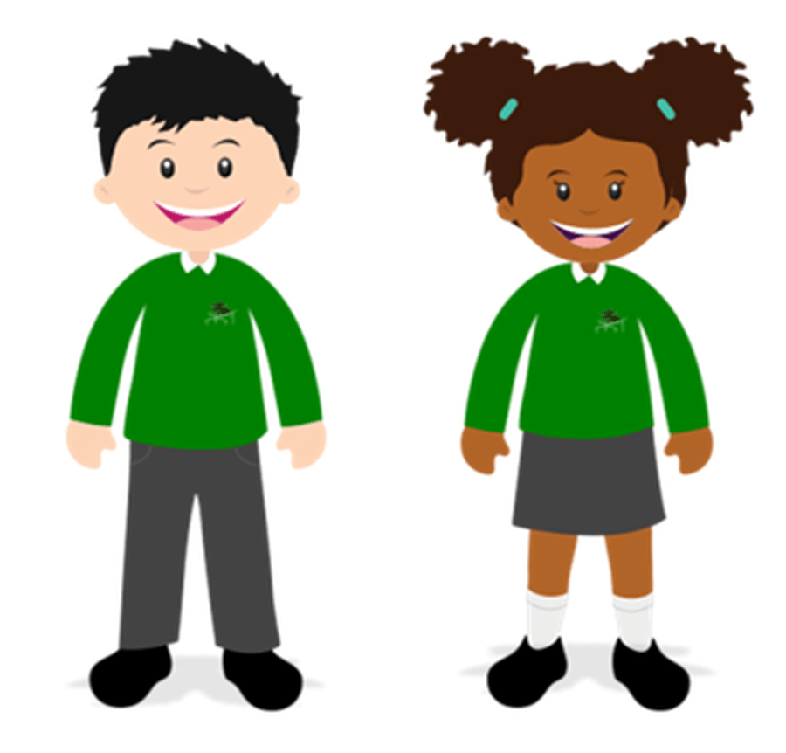

Where are areas of surplus and deficit located global
Knowledge and Understanding
RE
CURRICULUM MAP FOR THE REACH COLLABORATION OF SCHOOLS
Critical Thinking
Barbara Wintersgill’s big ideas are:
Big Idea 1: Continuity, Change and Diversity
Big Idea 2: Words and Beyond
Big Idea 3: A Good Life
Big Idea 4: Making Sense of Life’s Experiences
Big Idea 5: Influence and Power
Big Idea 6: The Big Picture
The Golden Threads for RE:
Belief
Belonging
Festival
Celebration
Identity
Pilgrimage/journeys
Prayer/worship
Symbolism
Personal Reflection
Year 6 Units:
What is it like to follow a Muslim way of life in Britain today?
Christmas past and present
Journeys and Pilgrimages
Easter: The Afterlife
Precious and the Natural World
Inclusion (working together for the world)
YEAR
Year 6 Principal Religions – Christianity and Judaism
6
Have more detailed knowledge and understanding of concepts across several religious and non-religious worldviews, using wide ranging technical vocabulary.
Have more detailed knowledge and understanding of how these concepts connect to form a framework for understanding religious and non-religious worldviews.
Have knowledge of the diversity of religious and non-religious worldviews within the local, national and global context, and show understanding of similarities and differences between them.
Pupils show appreciation of different perspectives, recognising the reasons given to support these viewpoints (see both sides of an argument).
In response to the material they learn about, pupils can raise controversial questions, express their opinions and use sound reasons to back these up.
YEAR
5
Year 5 Principal Religions - Christianity and Islam
Year 4 Units:
Worship and Worshipping – a comparison of Islam and Christianity
Christmas – The Journey of the Shepherds
Journeys and Moving On –Christianity (Mary Jones)
Easter Through Art - The Story Through the Eyes of Gary Bunt: Bert, His Dog, Our God
Inclusion (community working together)
Year 5 Units:
What is it like to follow a Jewish way of life in Britain today?
Christmas around the world
Faith in Action
Art Through Easter
Humanism
UPPER
KEY STAGE
2
YEAR
Year 4 Principal Religion - Christianity
4
Be able to describe some of the beliefs, teachings and expressions of beliefs within the religions studied and how these have an impact for individuals and communities.
Begin to form a framework of connections between these concepts by making some links between them.
Identify some patterns between or within religions (a range of religious and non religious worldviews) by comparing similarities and differences.
In response to the material they learn about, pupils can raise questions, express their opinions and support these with plausible reasons.
They recognise that others may think differently and have different opinions.
YEAR
3
Year 3 Principal Religions - Christianity and Sikhism
Year 2 Units:
Jesus is a special person
Celebrations of Light and Life
Faith stories - Journey of Rama and Sita (Hinduism)
Making Sense of Life’s Experiences Stories and People/ Authority
Easter celebrations and symbols
Our Planet
Believing - How do people demonstrate their beliefs?
Year 3 Units:
What is it like to follow a Muslim way of life in Britain today?
Special people and special places
What is it like to follow a Sikh way of life in Britain today?
Easter - Forgiveness - Was it fair that Jesus died to save us? Should we always forgive?
Religious Leaders - What can we learn?
LOWER
KEY STAGE
2
YEAR
Year 2 Principal Religion – Christianity and Hinduism
2
Have simple knowledge of some of the beliefs, teaching/stories and practices of specific religions studied, using simple technical vocabulary
Have simple
knowledge of some
of the similarities
and differences
between and within
the religious and non-religious
worldviews they
learn about.
Have simple knowledge of why these beliefs and practices may be important to people.
In response to the material they learn about, pupils can raise questions, express their opinions and back them up with simple reasons.
YEAR
1
Year 1 Principal Religions- Christianity , Judaism and Hinduism
Year 1 Units:
What is it like to follow a Christian way of life in Britain today?
Celebrations (Harvest, Hanukkah Thanksgiving, Christmas)
What is it like to follow a Jewish way of life in Britain today? - Life from the perspective of a Jewish Child
The Story of Easter - Beliefs and practices
What makes a place of worship special? A comparison of Christianity and Judaism.
Belonging
What does it mean to belong?
KEY STAGE
1
Emphasis on exploration in the Early Years with all units called ‘Let’s find out about…’
EYFS
ELG: People, Culture and Communities : Children know some similarities and differences between different religious and cultural communities in this country, drawing on their experiences and what has been read in class.
ELG: Self-Regulation: Show an understanding of their own feelings and those of others and begin to regulate their behaviour accordingly.
‘

