Slide 1
RAINMAKERS

Slide 2
If you still have your long kitchen roll inners (x2 and stuck together to make one long tube) or an alternative tubing we are going to make rain makers linked to our story of Lila and the Secret of the Rain. It is planned over two days as you’ll need to let the paint dry to add patterns.

Slide 3
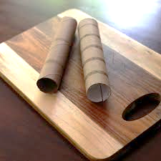
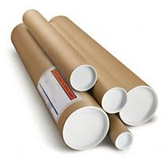
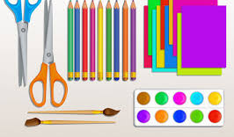
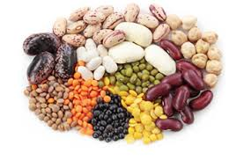
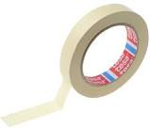
You will need:-
tubing
Colours such as paints, pens, fabric, scissors, tape.
Make lids with card at each end. If you have lids already- even better.
Dried beans, pasta/ lentils to shake
Foil/ pipe cleaners/ wooden sticks/ old washing line

Slide 4
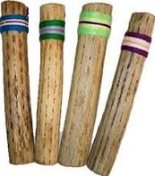
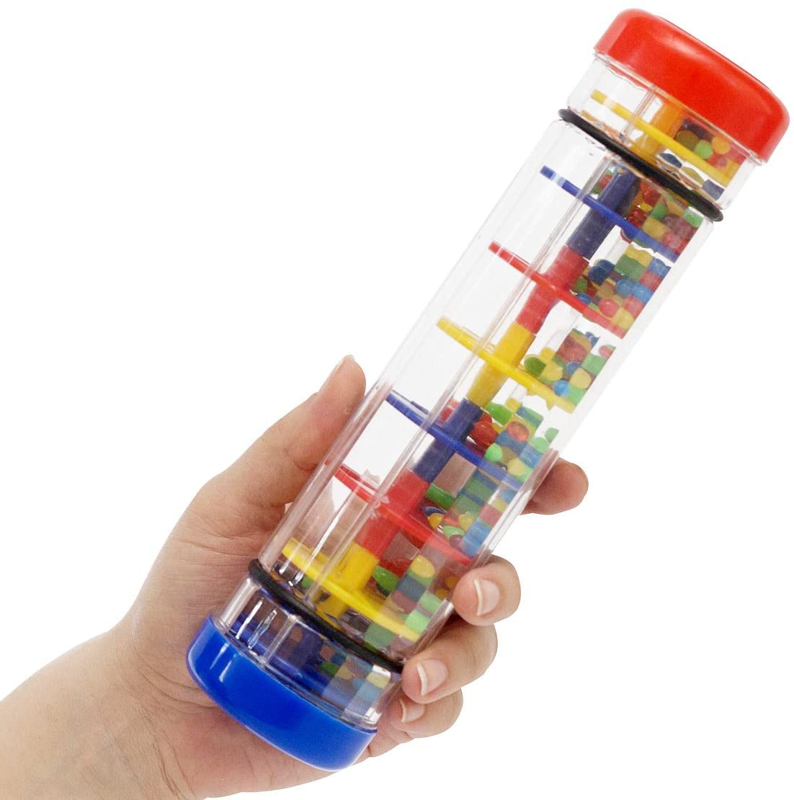
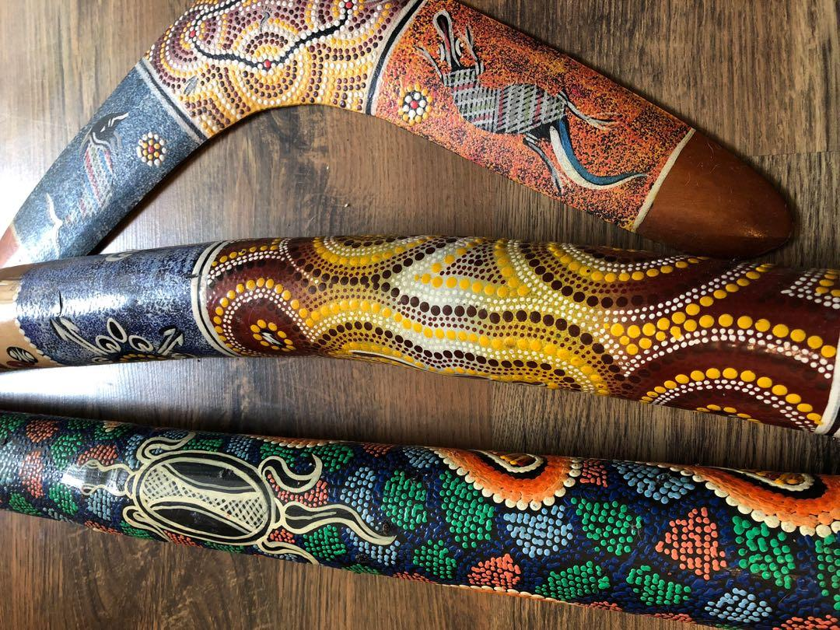
Lila didn’t use a rainmaker in the story but in some cultures, these are instruments that make music to the gods in the hope of rain. You may have owned your own rainmaker in the form of a rattle when you were younger.

Slide 5
First you need to think of how dried peas, beans, pasta or rice will trickle down so something in the middle needs to slow their fall.

Slide 6
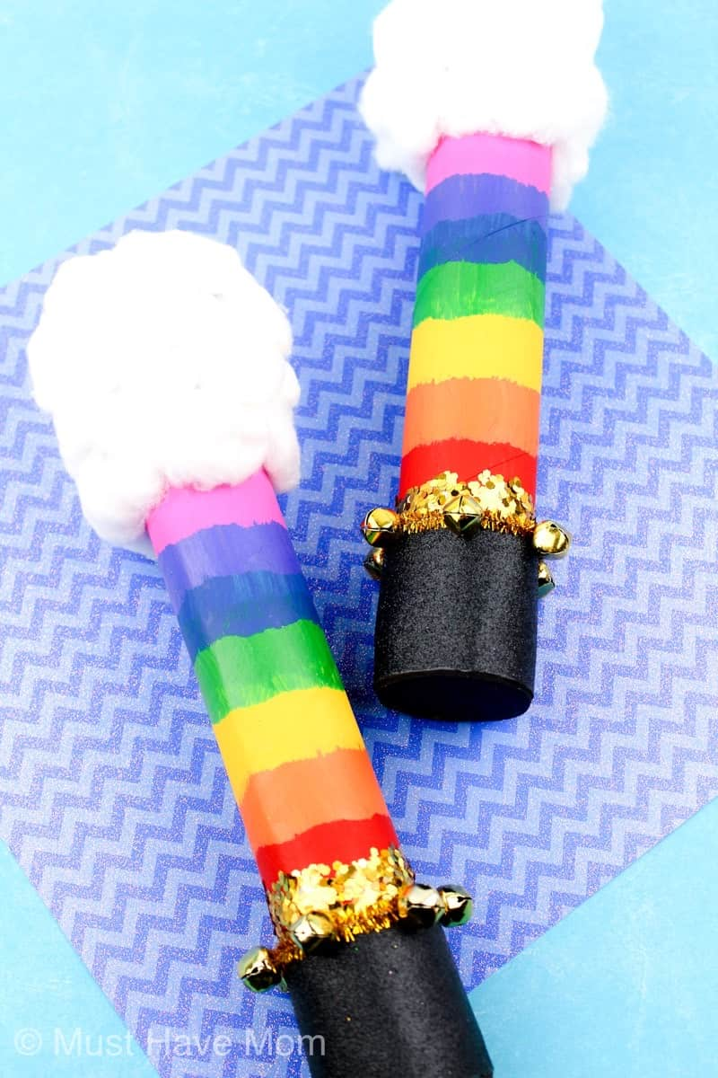
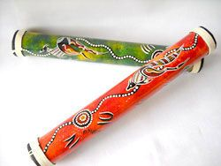
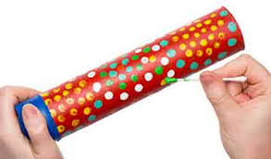
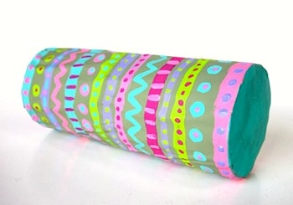
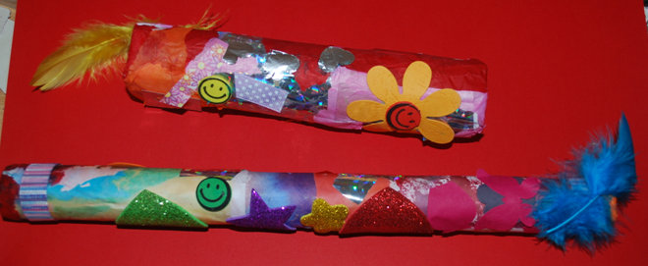
Decorate the outside of your rainmaker. If you are using paint- do an undercoat today and then add finer patterns tomorrow when dry. You may want to use pens, ribbons or different fabrics. Look at the other examples- repeated patterns or pictures of animals? You decide.

Slide 7
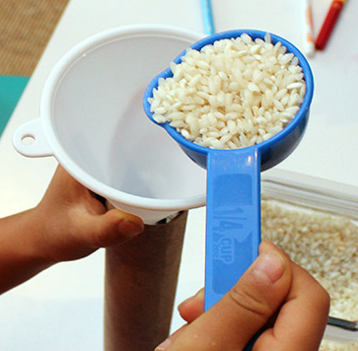
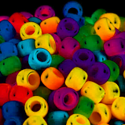
Make sure one end is sealed before pouring in different things such as beads, dried beans, peas, rice or pasta so that it will make a noise when shook. Seal the top so no esca-peas!!

Slide 8
There you have it… a rainmaker for when it gets too hot. Now what rhythm can you think of to make some music?

