Slide 2
What weather does this symbol forecast?
sunny

Slide 3
What weather does this symbol forecast?
partly cloudy

Slide 4
What weather does this symbol forecast?
cloudy

Slide 5
What weather does this symbol forecast?
clear (night)

Slide 6
What weather does this symbol forecast?
cloudy (night)

Slide 7
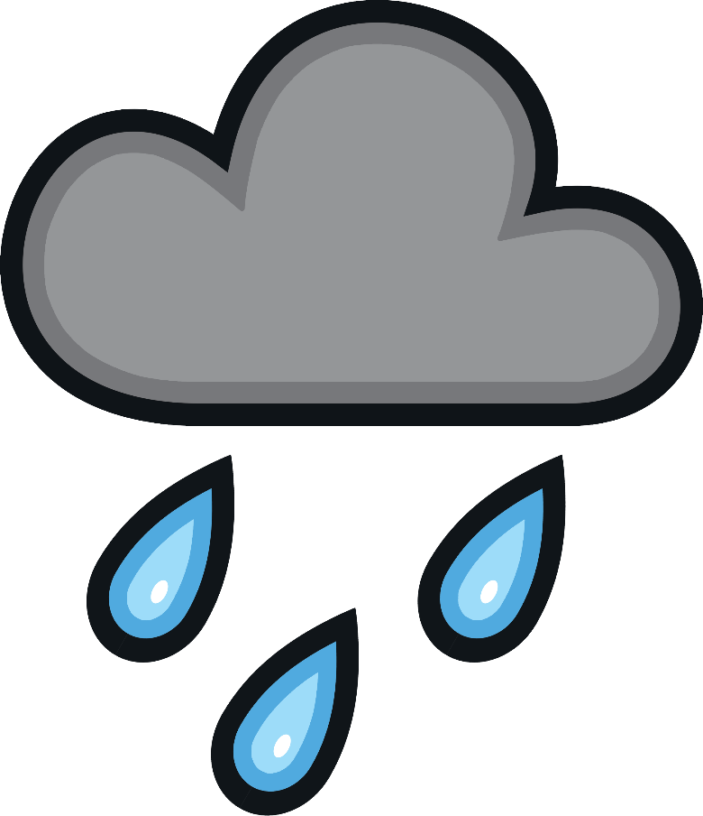
What weather does this symbol forecast?
rain

Slide 8
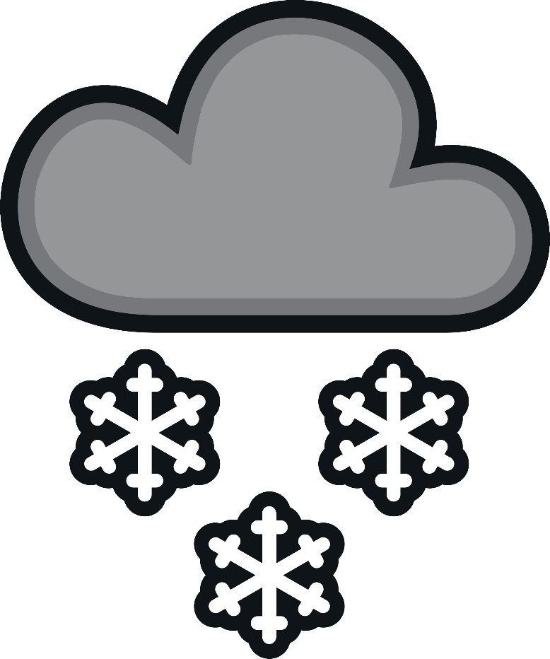
What weather does this symbol forecast?
snow

Slide 9
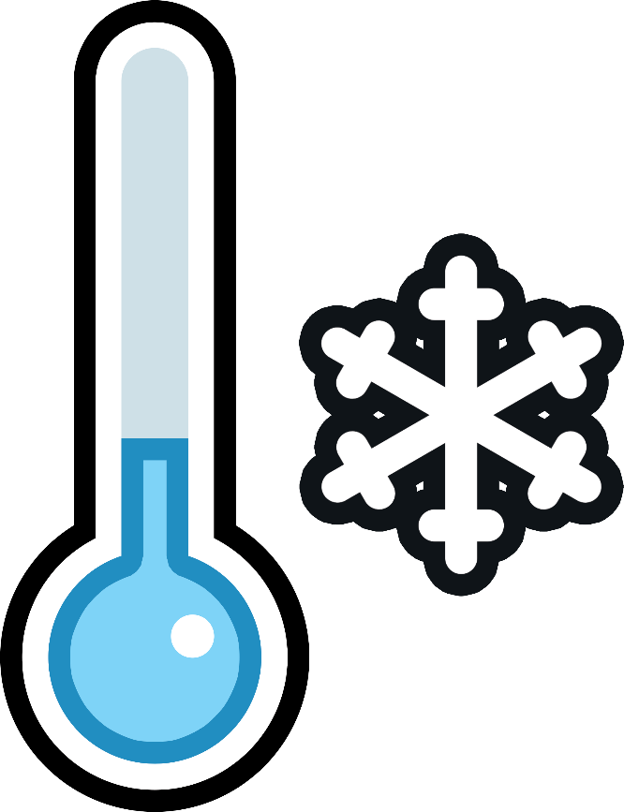
What weather does this symbol forecast?
cold temperatures

Slide 10
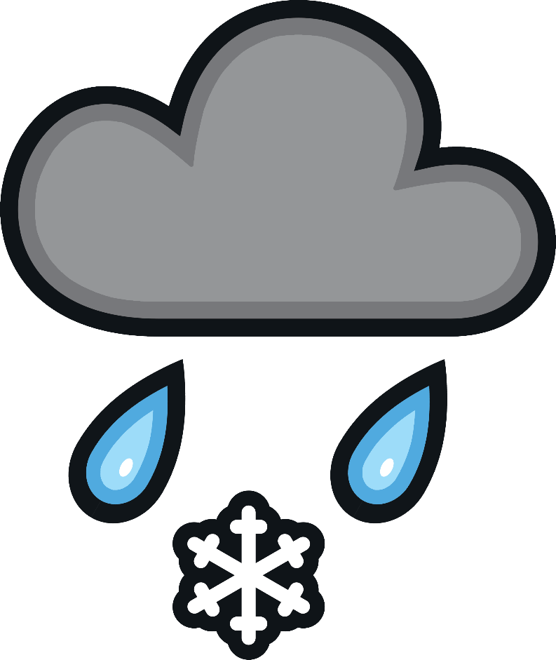
What weather does this symbol forecast?
scattered snow

Slide 11
What weather does this symbol forecast?
windy

Slide 12
What weather does this symbol forecast?
fog

Slide 13
What weather does this symbol forecast?
sunrise

Slide 14
What weather does this symbol forecast?
sunset

Slide 15
What weather does this symbol forecast?
smoke

