Slide 1
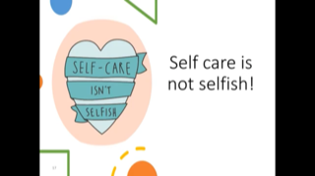
Anxiety: supporting pupils, staff and parents.
Thingwall Primary January 2021
S.E. Calveley
scalveley@aol.com

Slide 2
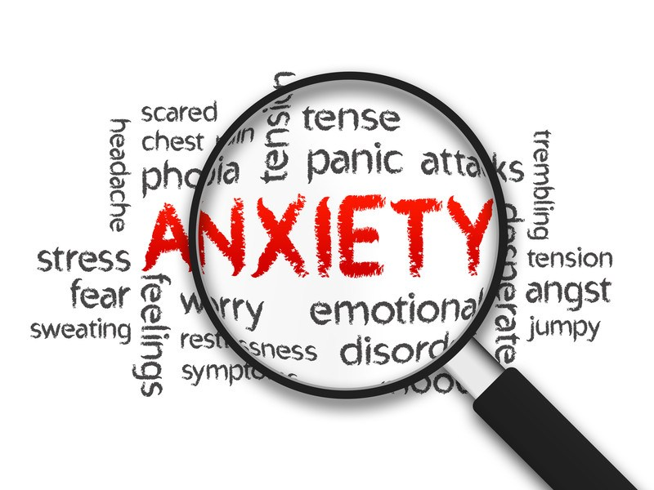

Slide 3
Notes:
See EHWB checklist as a baseline.

Slide 4
Part 1 : Staff
Notes:
In order to return to work you need to be in the best place you can mentally.

Slide 5
Notes:
In order to support others we need to have good mental health and be in a good place. For some this has been a positive experience a time to slow down for others it has been a time of increased anxiety and uncertainty. Some will have suffered personal loss.

Slide 7
Do not put most vulnerable staff to support children with significant MH issues.

Slide 8
Talking about how you feel.
Happy and bright / good to go
Weathering the storm/
Angry, emotional, irrational
Uncertain/ confused not 100%
Skating on thin ice
This Photo by Unknown Author is licensed under CC BY-SA
Notes:
Discuss the different images

Slide 9
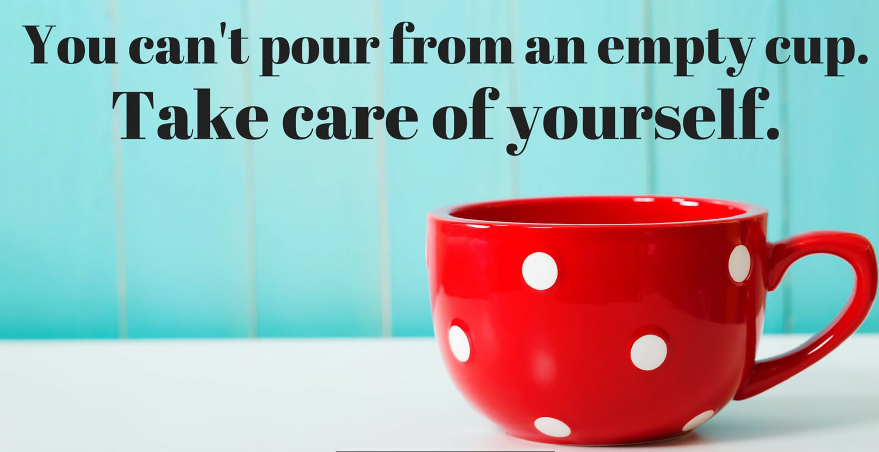
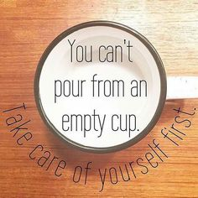
Notes:
You need to find ways of regaining self confidence and self control.

Slide 10
Notes:
Give out stress bucket handout.

Slide 11
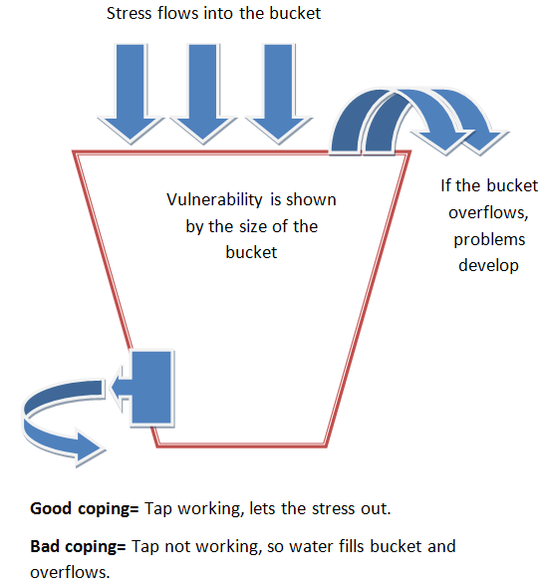
My Stress Bucket
Think about your own bucket
What stressors pour in?
How do I cope?
How do I know when its nearly full?
What happens when it overflows?
Notes:
Worksheets in pack, stay safe, do by self Complete my coping sheets

Slide 12
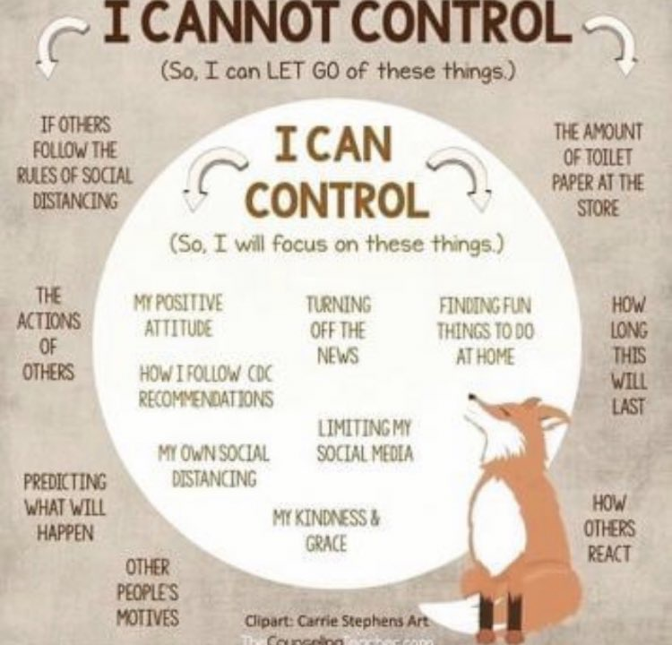
Taking back control/ moving forward
Notes:
Many adults feel they have lost control of their lives or a sense of structure.

Slide 13
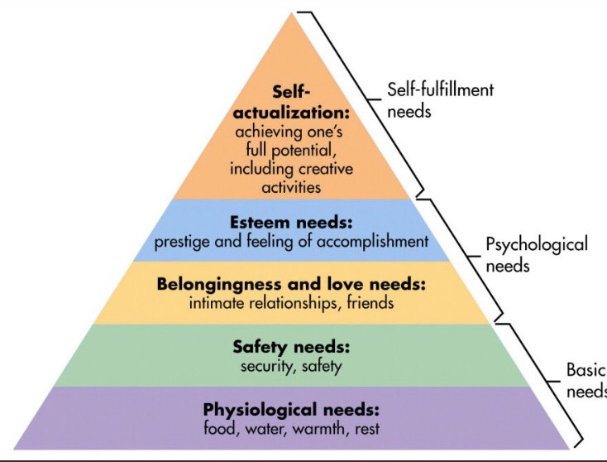
Maslow’s hierarchy of needs
Notes:
Maslow’s hierarchy of needs

Slide 14
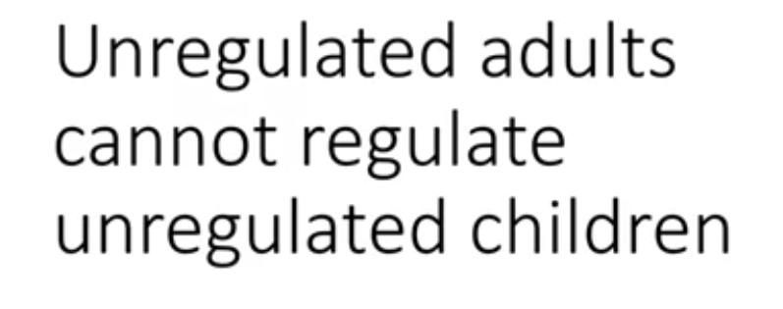
Notes:
Think about each of the four needs mentioned, which is important to you ?

Slide 15
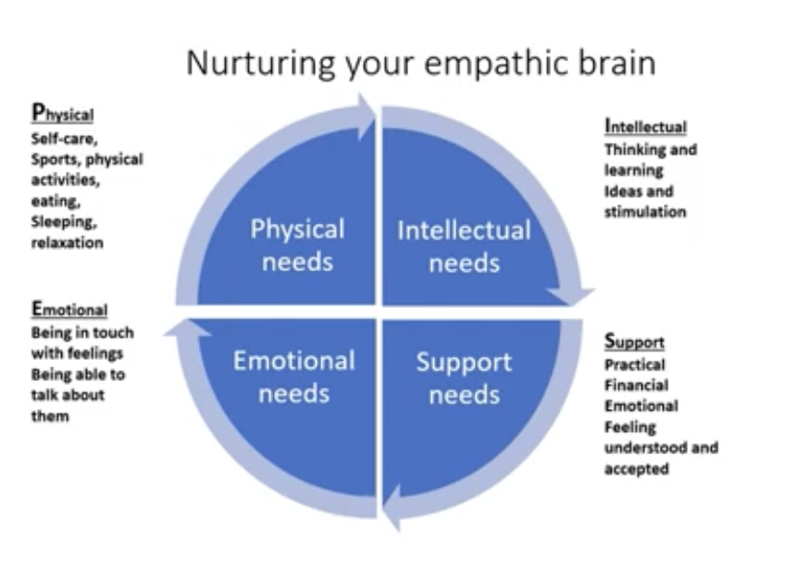

Slide 16
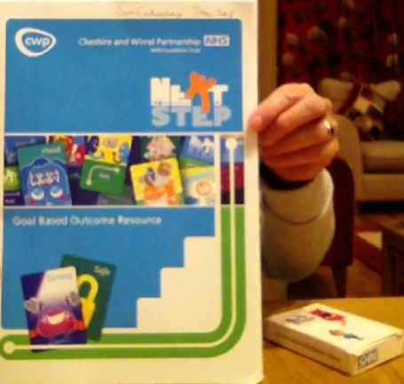
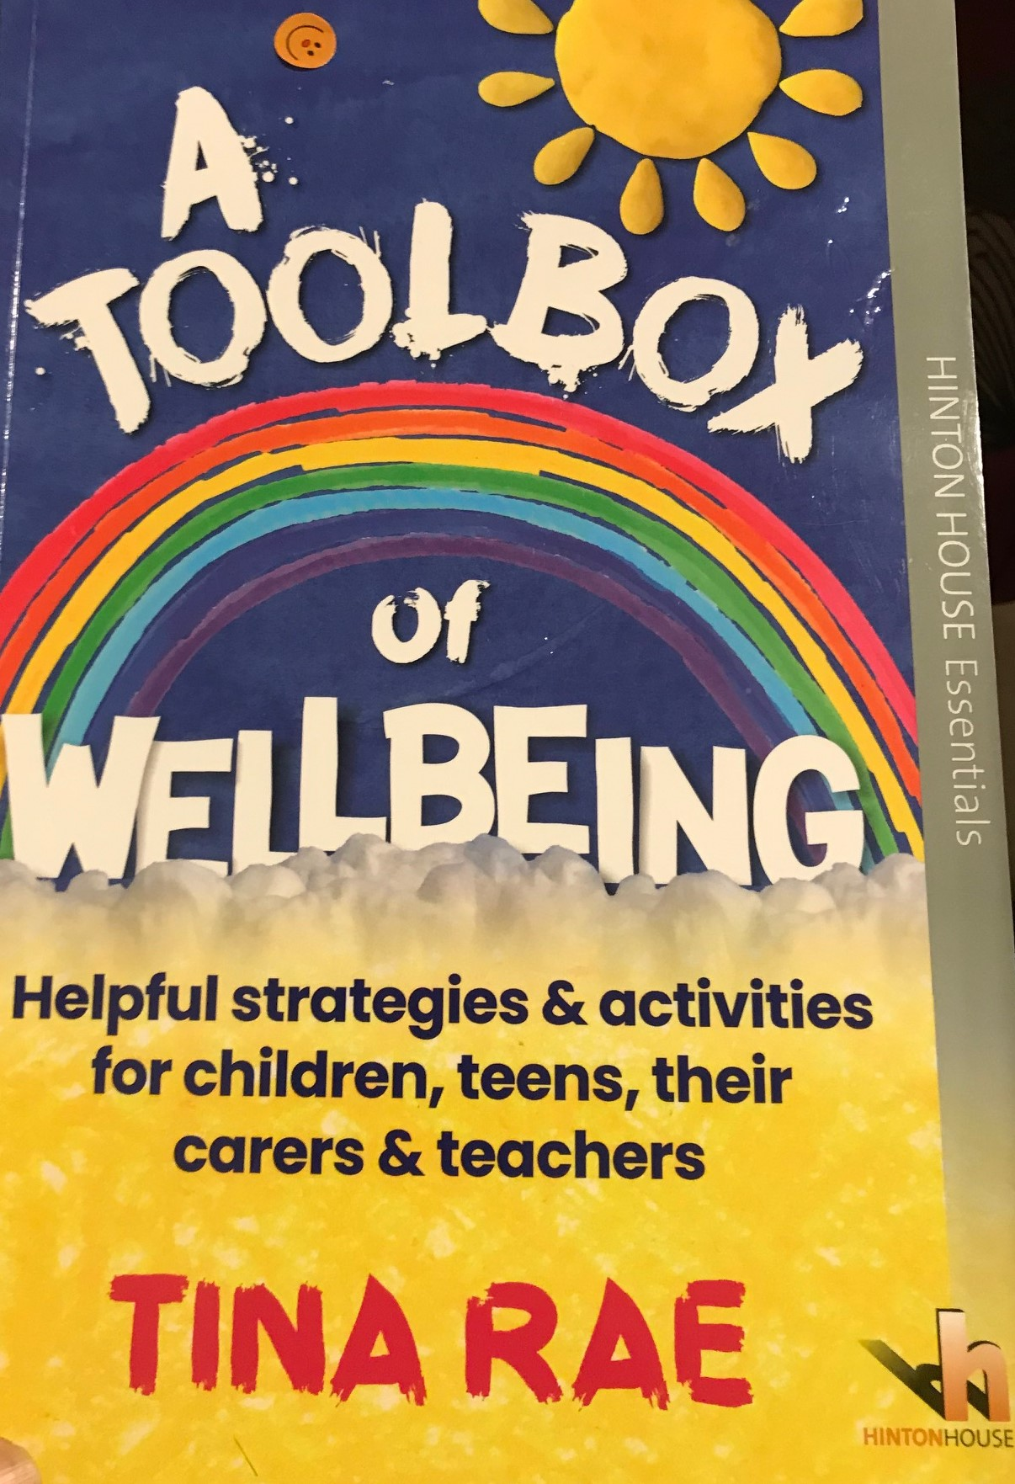
Resources
.
Notes:
Acknowledge that some slides have come from the free CPD I accessed from Dr Tina Rae during lockdown. Follow her on Twitter.
Anxiety www.moodjuice.scot.nhs.uk

Slide 17
Notes:
This is a great resource.

Slide 18
Part 2
Pupils: resources to support
Social and Emotional Aspects

Slide 19
The impact of coronavirus pandemic on children’s mental health and well-being.
Notes:
For some families the lockdown enabled them to bond, learn and play together for others it was a time of financial hardship, stressed relationships, bereavement.
Some children felt: isolated , lonely feared for uncertainty, over-ate others saw it as freedom from discrimination, bullying, a different pace of life, a better diet and less academic pressure.

Slide 20
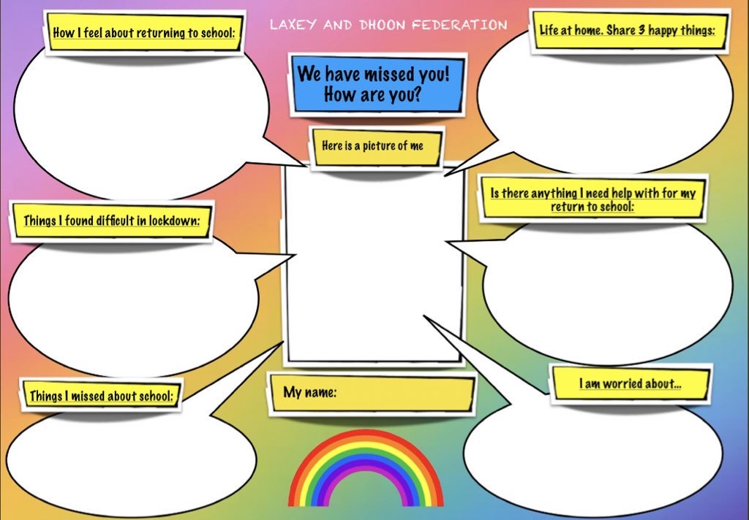
Share your worries
Notes:
This may be useful for those being home-schooled.

Slide 21
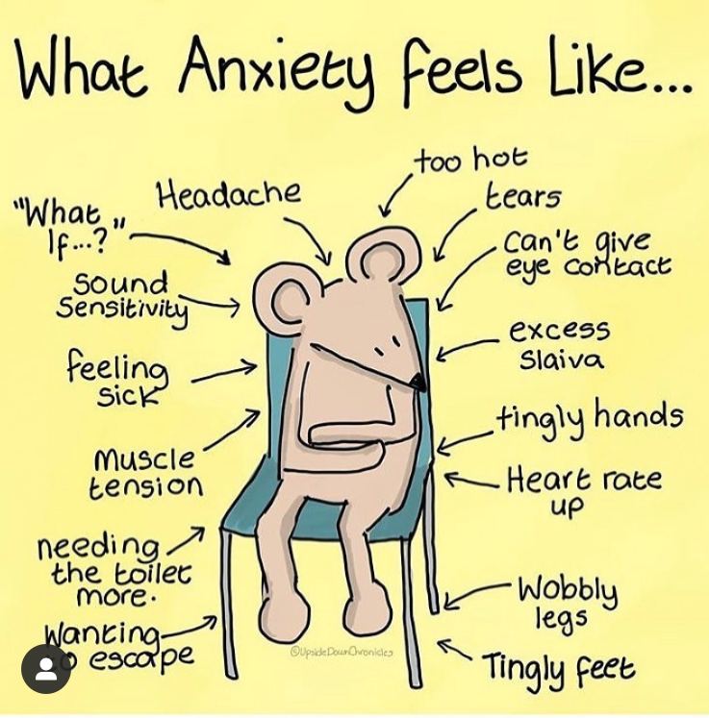
Notes:
We will see more behaviours we consider challenging due to anxiety,
Anger, sleeping/defiance, if you feel out of control you may be defiant.
Children who are traumatized find it hard to concentrate, and avoid certain situations.
They may over-plan to control situations.

Slide 22
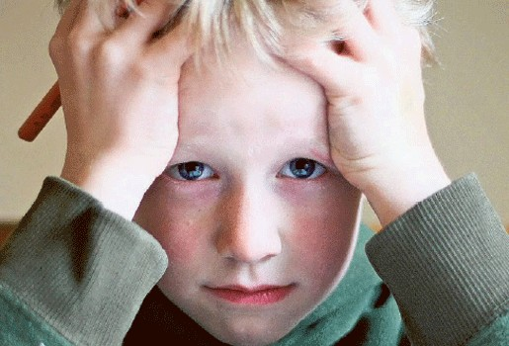
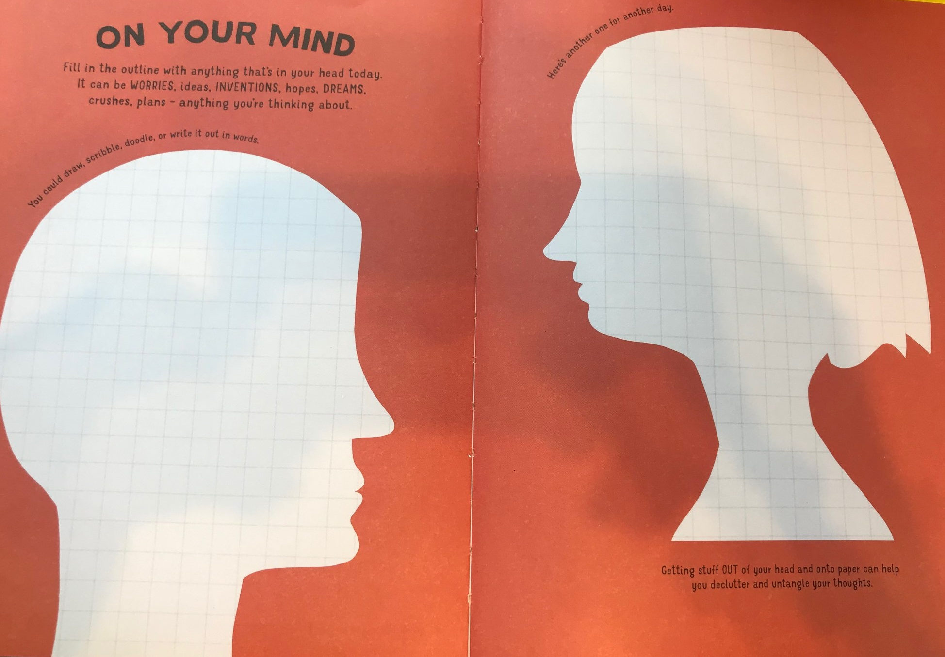
Activity 1
What’s on your child’s mind?

Slide 23
How am I feeling today

Slide 24
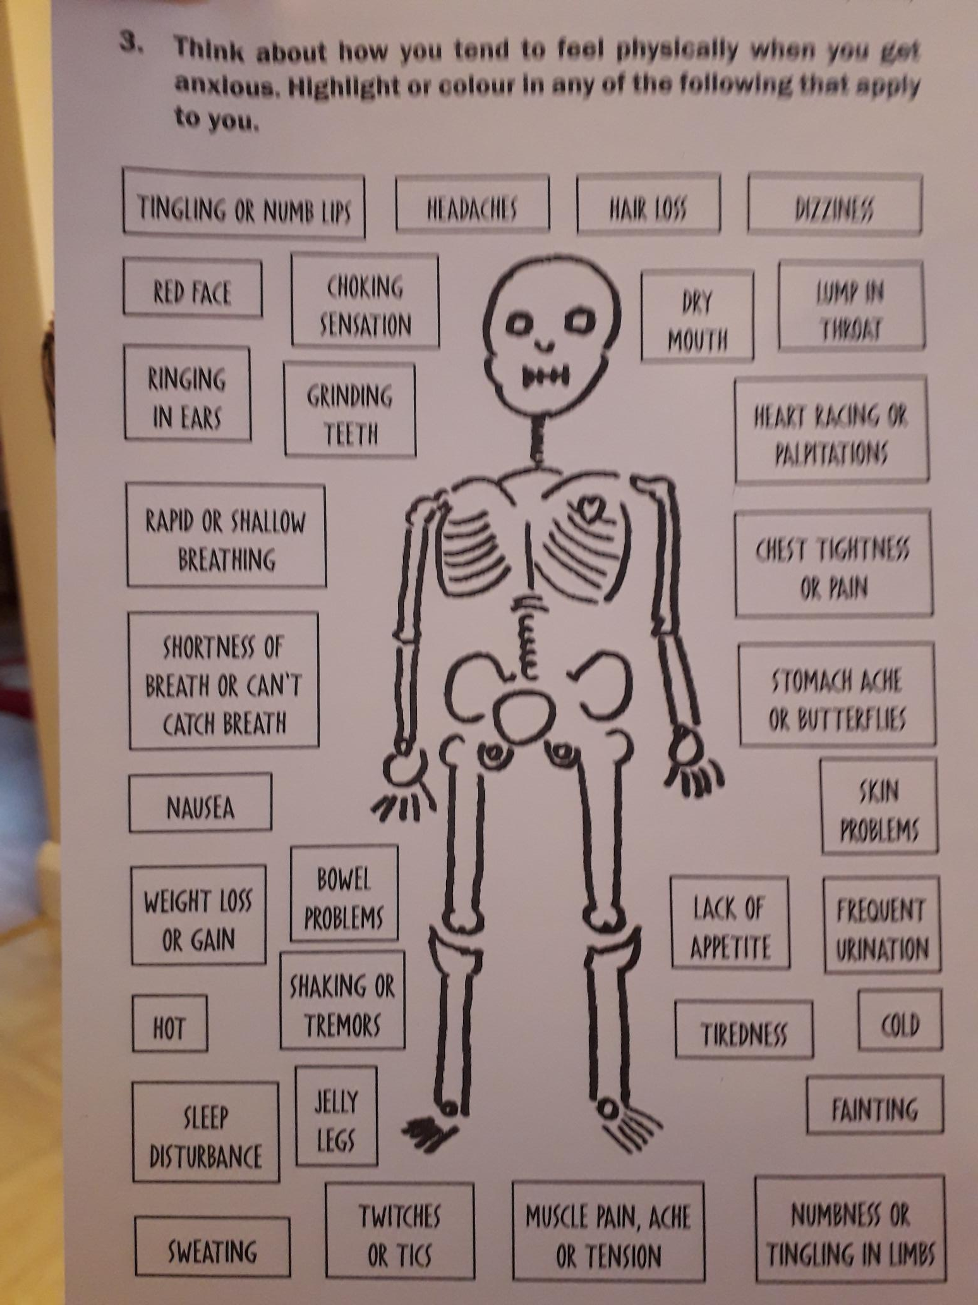
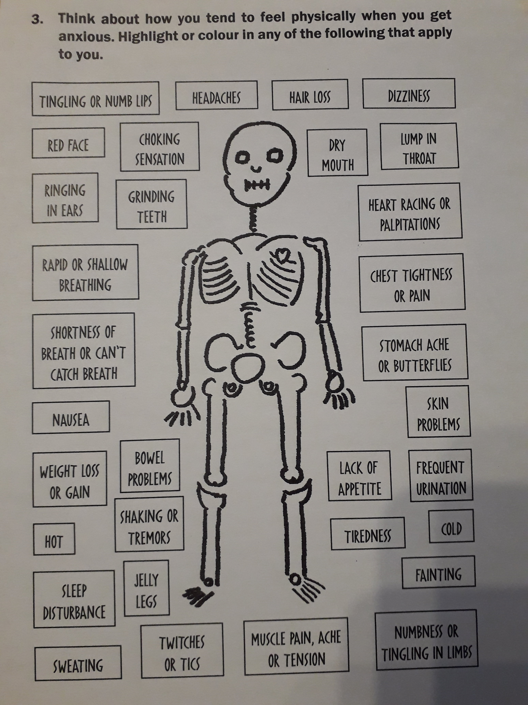
Lost for words ?
Activity
Skeleton
worried
on edge
trapped
panicky
nervous
restless
tense
Which of the following words do you
associate with your anxiety?
Notes:
Skeleton p 46. Word activity p 51: The Anxiety Gremlin

Slide 25
https://mentallyhealthyschools.org.uk/media/2022/anxiety-thermometer.pdf

Slide 26
https://mentallyhealthyschools.org.uk/media/2046/resilience-ladder.pdf
Notes:
Gradual exposure, baby steps.

Slide 27
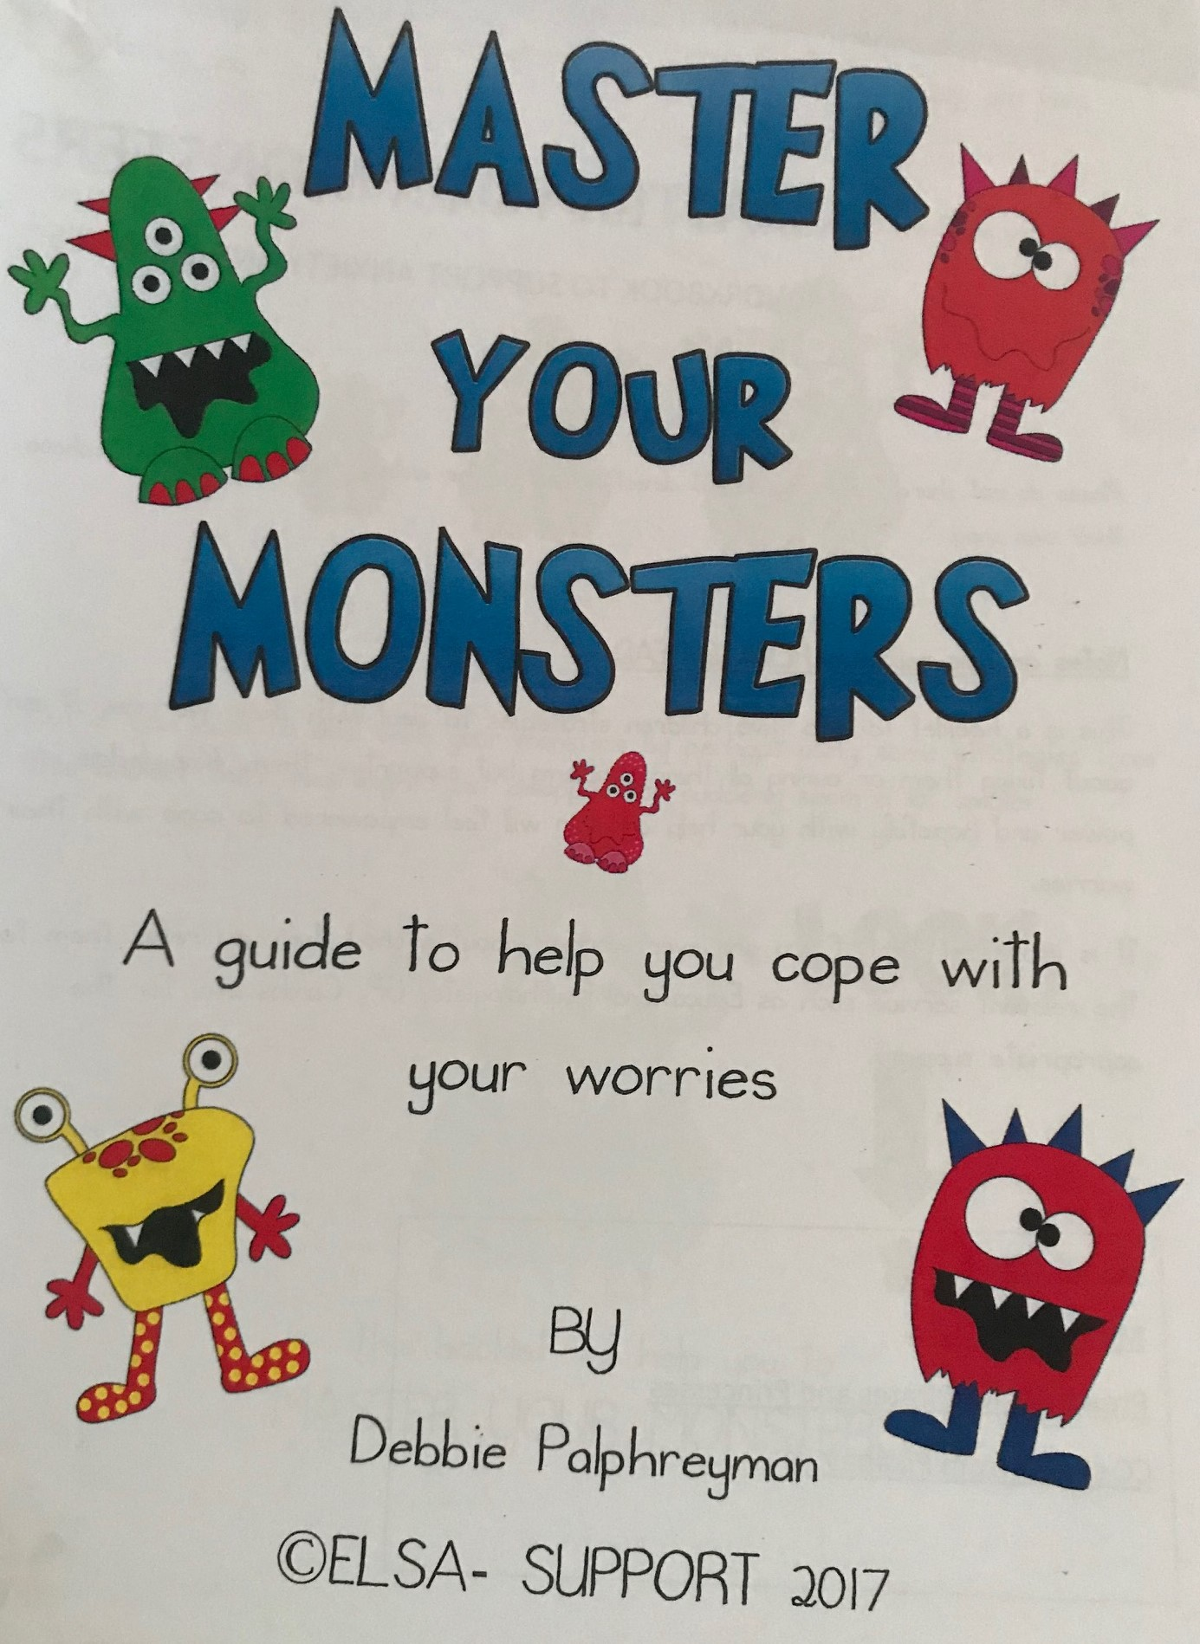
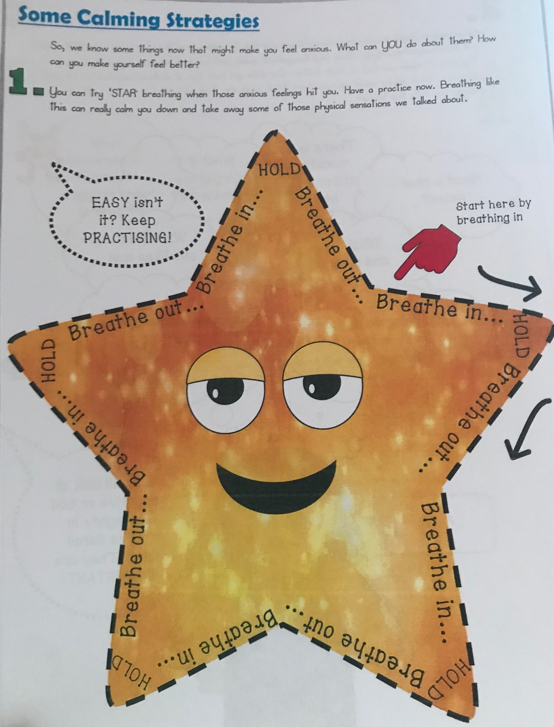
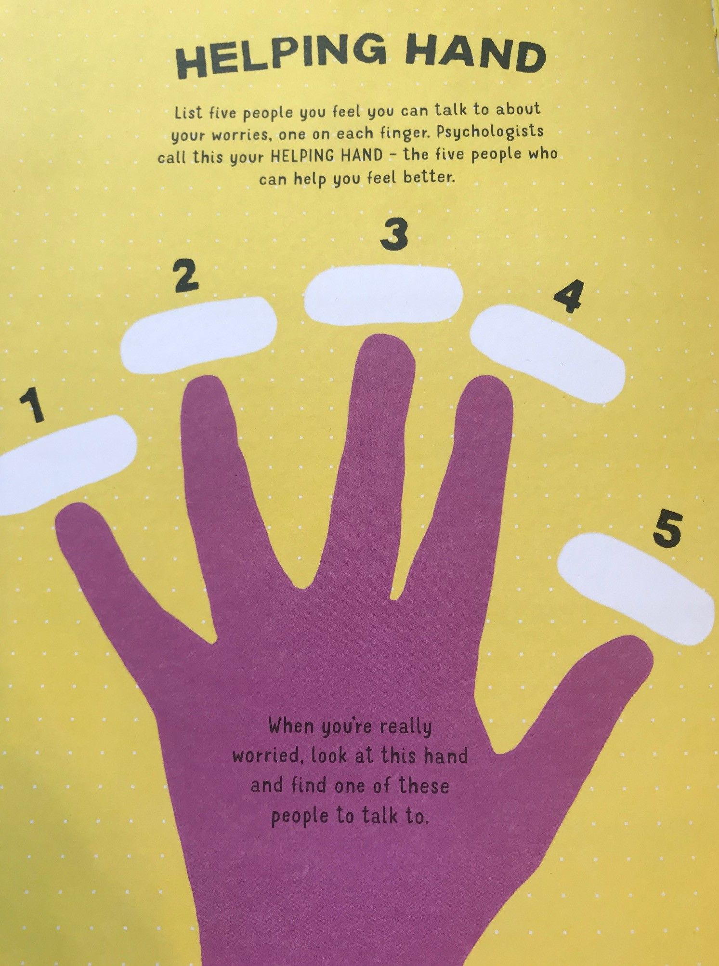

Slide 29
Useful resources
Useful resources

Slide 30
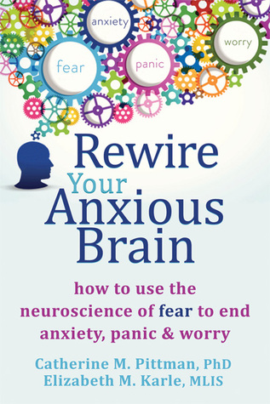
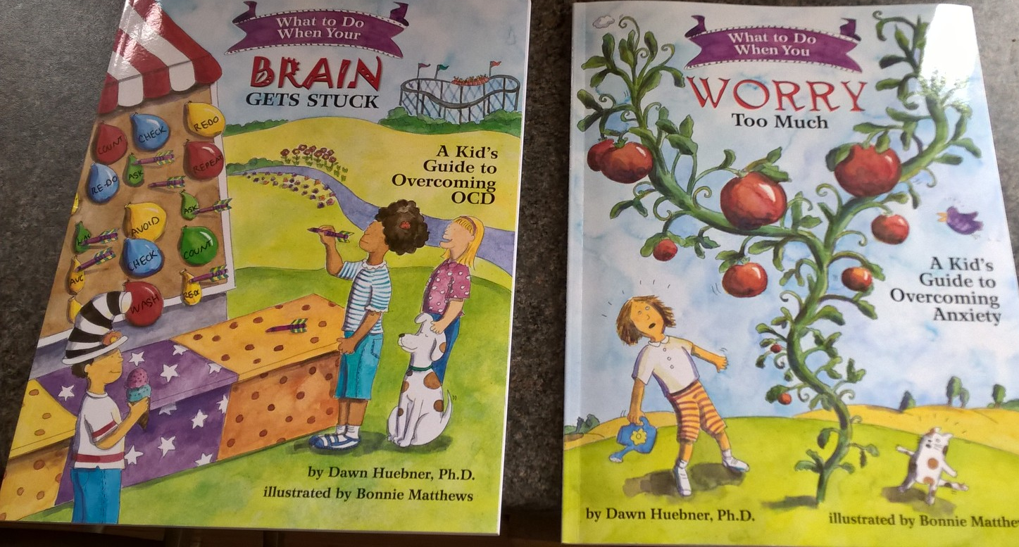
Notes:
https://www.bing.com/search?q=you+tube+bucketful+of+worries&form=EDGTCT&qs=PF&cvid=77db9e7d7aca4ddb9dc6c01c64aea628&refig=22d310de6ec64e9d8ed91cdb28488051&cc=GB&setlang=en-US

Slide 31
Part 3
Parents: resources to support
Social and Emotional Aspects

Slide 32
https://www.childline.org.uk/toolbox/games/balloon/
Notes:
Try this practical activity with staff

Slide 34
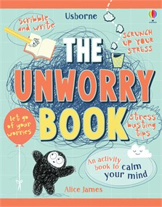
Track your mood

Slide 35
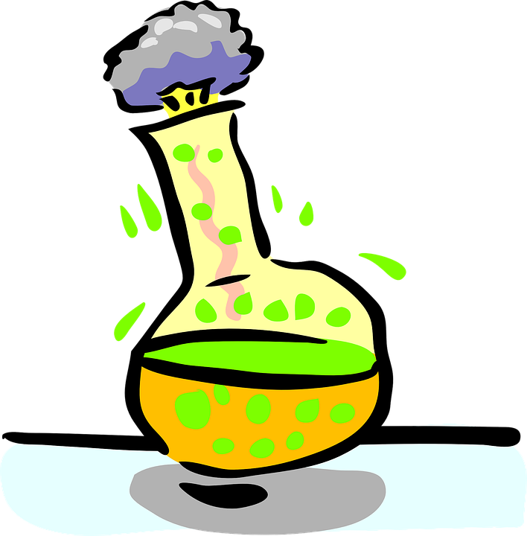
Talk time
Talk time is a specific time in the day that you can set aside to share your worries. This isn’t about spending time worrying for the sake of it:
Identify what is worrying you.
Identifying what you can do to address your worries.

Slide 36
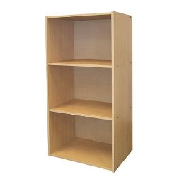
The Worry Shelf- prioritize your worries

Slide 37
Achievement shield

Slide 38
The self-esteem flower

Slide 39
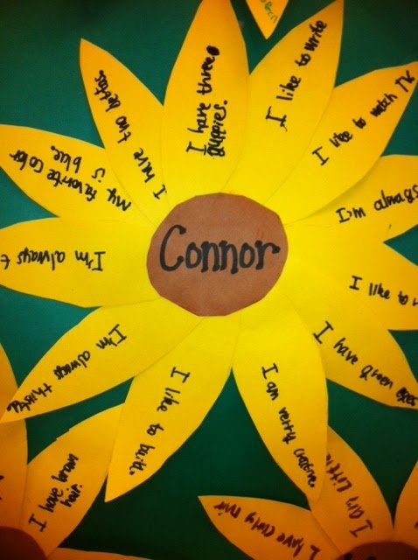
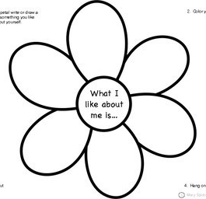
Building self-esteem

Slide 40
Relaxation Techniques

Slide 41
My favourite resource/ a workbook for you to share or your child to dip into.
Also available now, The Unworry Doodle Book £6.99 and
The Unworry Magic painting book £5.99.
£8.99

Slide 42
Two more favourites for you to dip into:

Slide 43
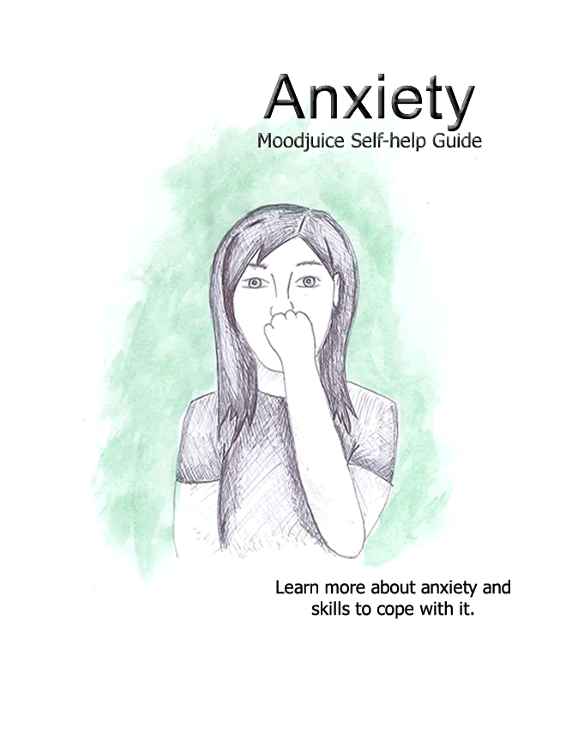
http://www.moodjuice.scot.nhs.uk

Slide 44
Thank you so much for joining me today. I am here to support you, do contact me at any time: scalveley@aol.com

