Slide 2
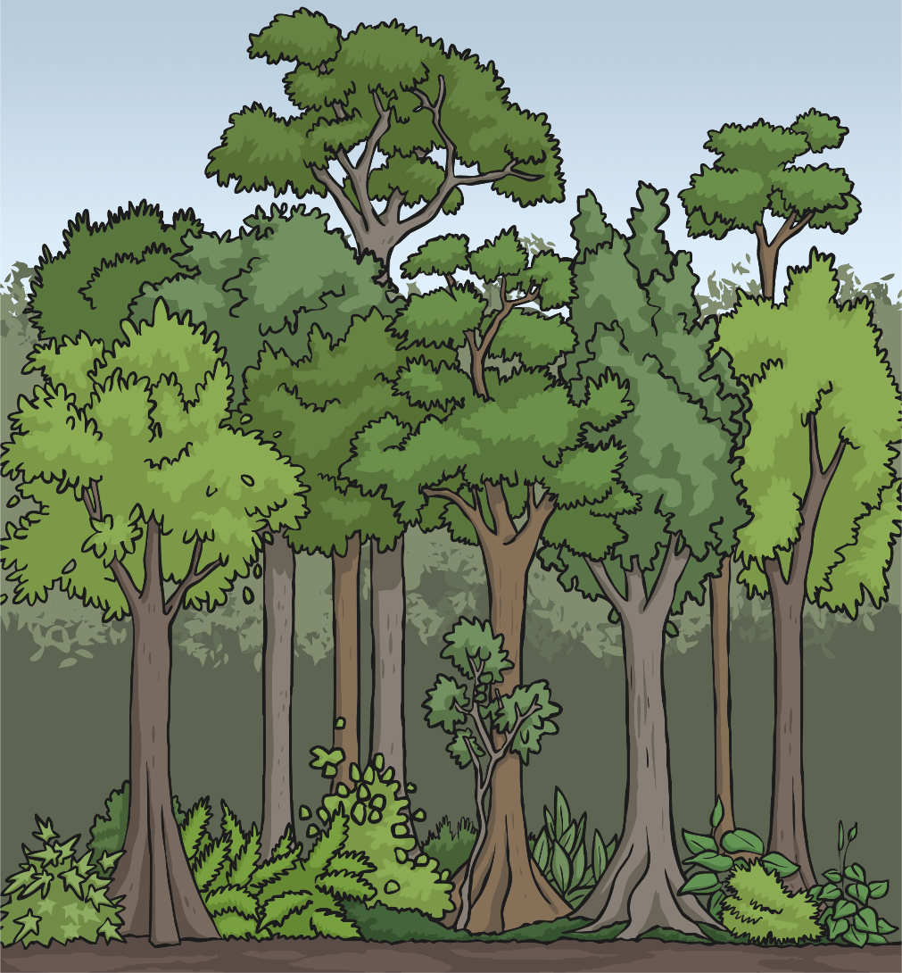
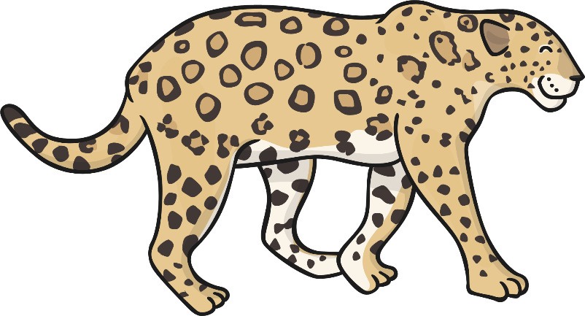
The Rainforest
The rainforest is made up of four different layers:
the emergent layer
the canopy layer
the understory layer
the forest floor layer

Slide 3
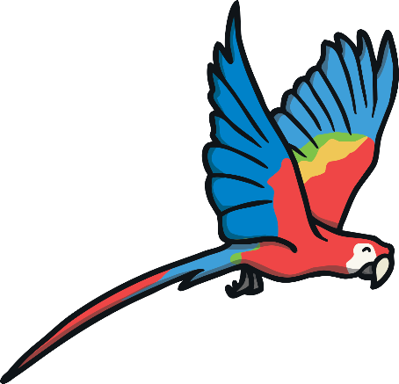
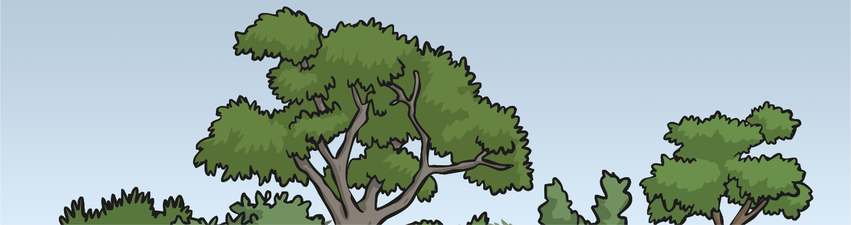

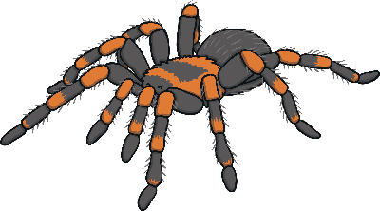
The Emergent Layer
This is the top layer of the rainforest.
Only a few animals live in this layer.
It is hot, wet, and windy in the emergent layer.
Some of the animals that can be found in the emergent layer are bird-eating tarantulas, hummingbirds,
and macaws.

Slide 4
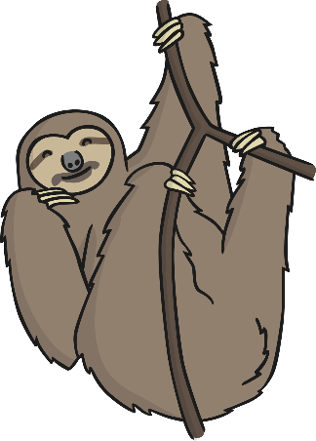
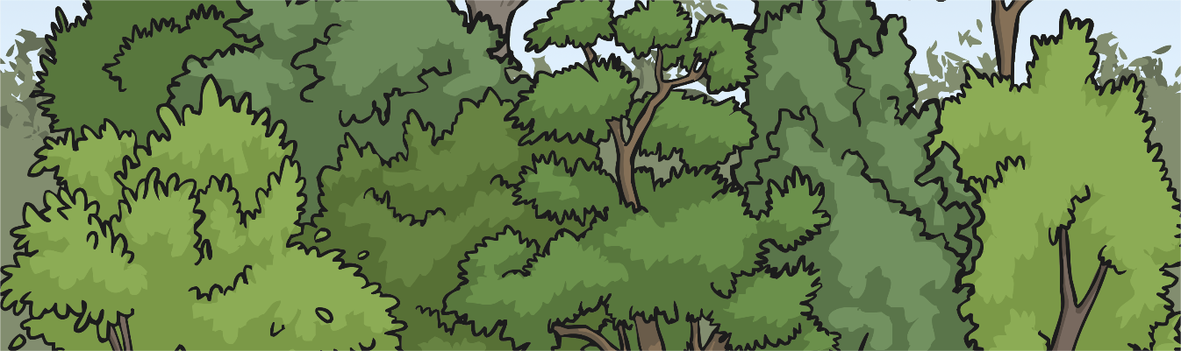
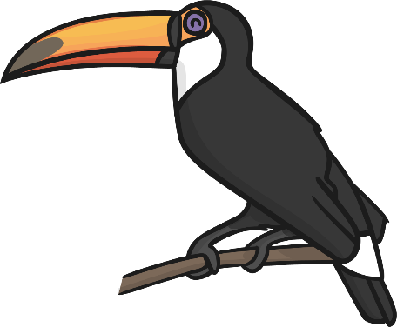

The Canopy Layer
The canopy layer is located under the emergent layer.
The canopy is home to most of the animals and plants of the rainforest.
There is plenty of food and shelter in this layer.
Red-eyed tree frogs, sloths, and toucans are some of the animals that live in the canopy layer.

Slide 5
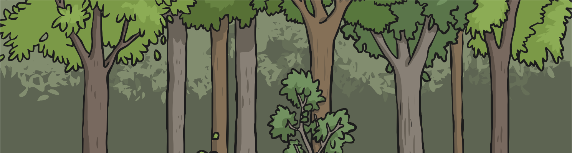
The Understory Layer
The understory layer is located beneath the canopy.
The understory does not get much sunlight.
It is dark and humid here.
The understory is home to smaller animals,
insects, and snakes.
Some larger animals use the understory layer for hunting.

Slide 6

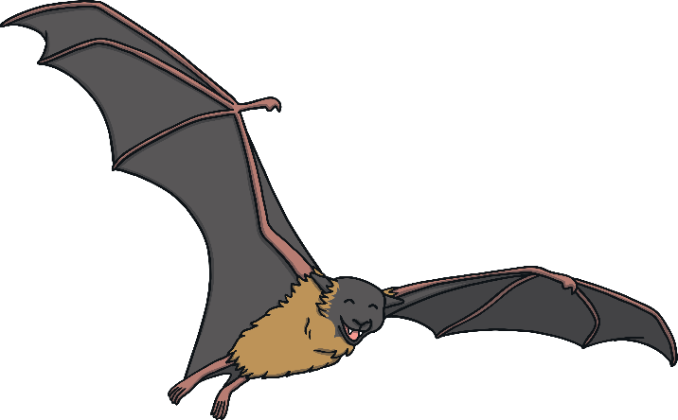
The Understory Layer
Geckos, bats, and boa constrictors are some of the animals that make their home in the understory layer.

Slide 7
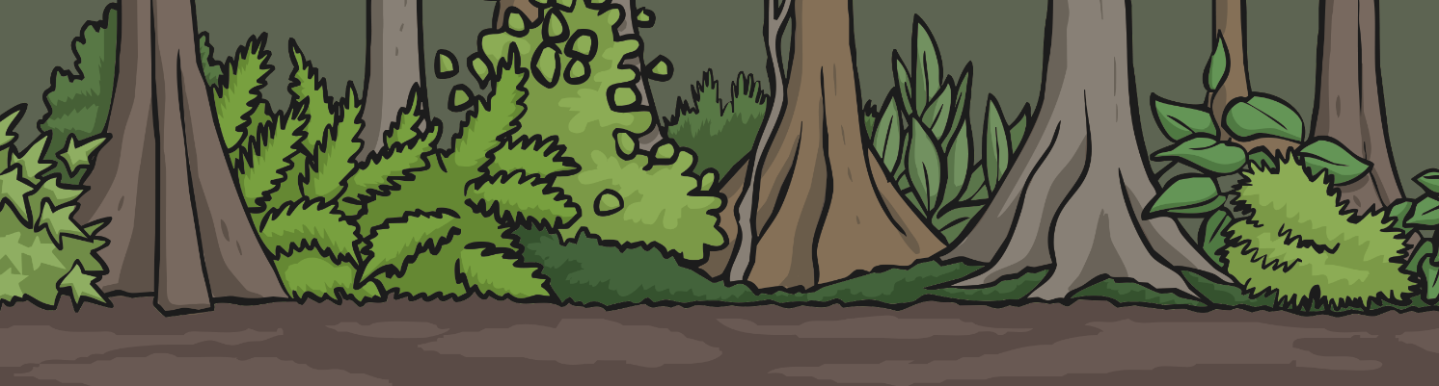

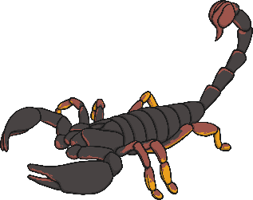
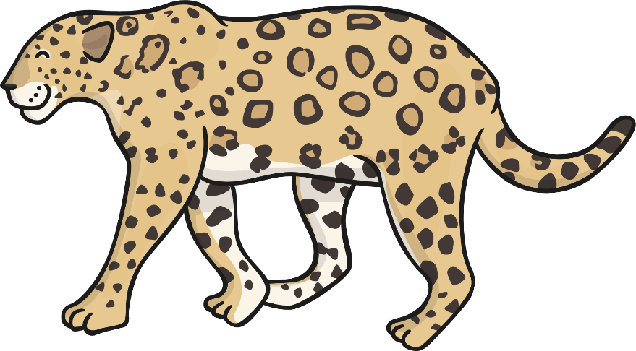
The Forest Floor Layer
The last layer of the rainforest is the forest floor layer.
This layer is dark, humid, and hot. Only 5% of the sunlight makes it to the forest floor.
Anteaters, jaguars, and scorpions are some of the animals that live in the forest floor layer.

Slide 8
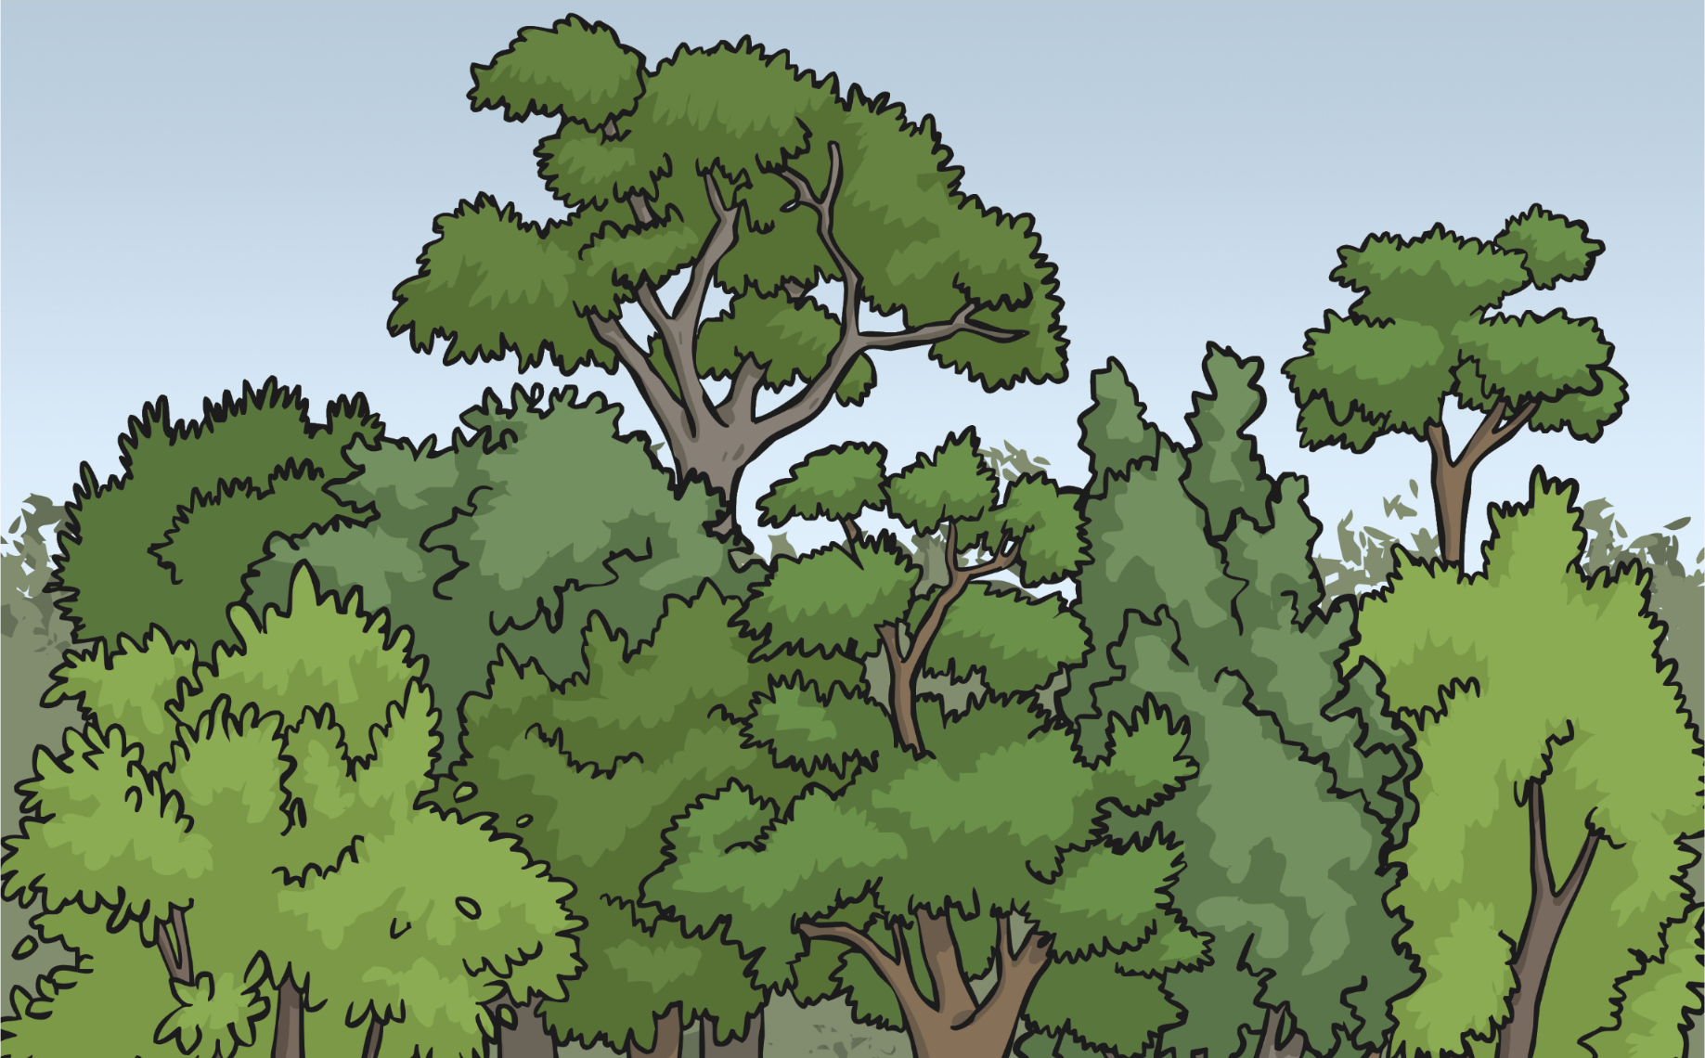
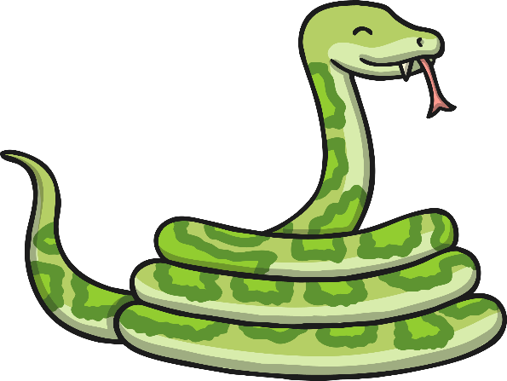
Animals in the Rainforest
The animals of the rainforest do not usually stay in only one layer. Some animals can be found in several different rainforest layers.
Some animals may live in one layer and hunt in another
layer of the rainforest.

Slide 9
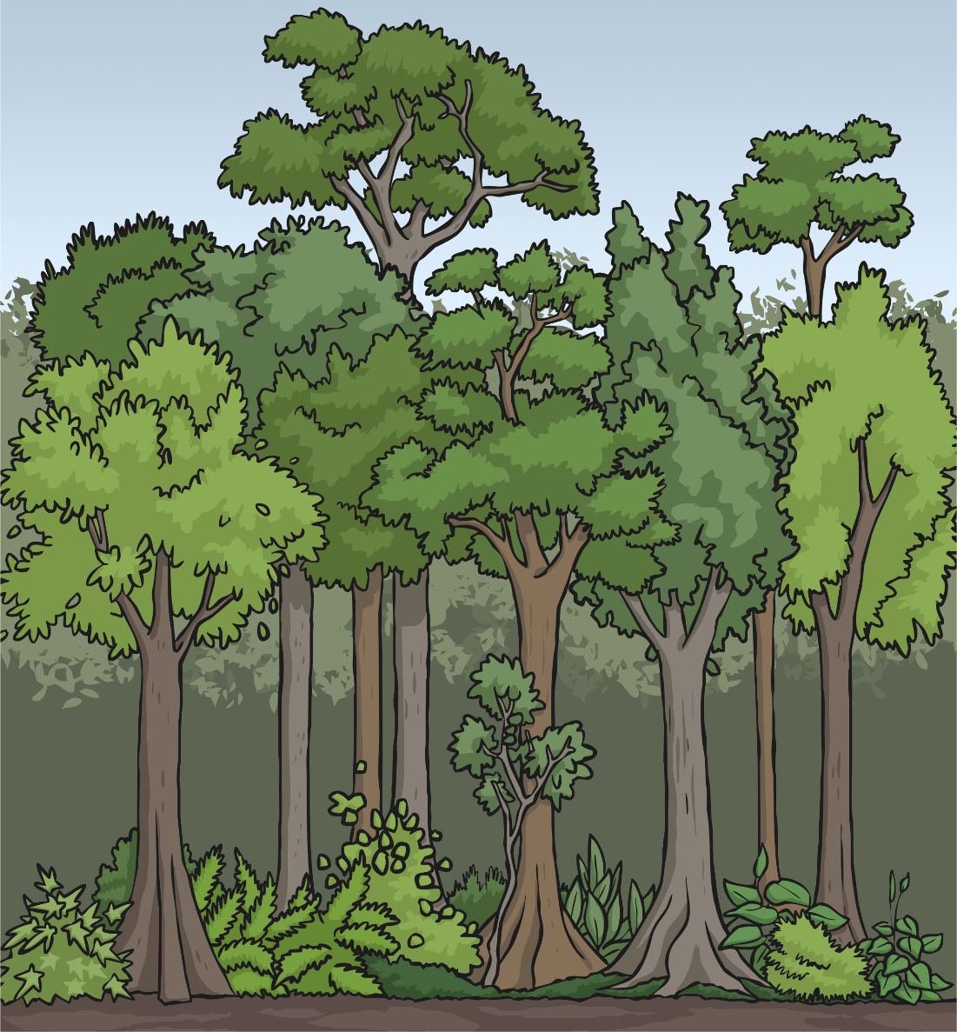



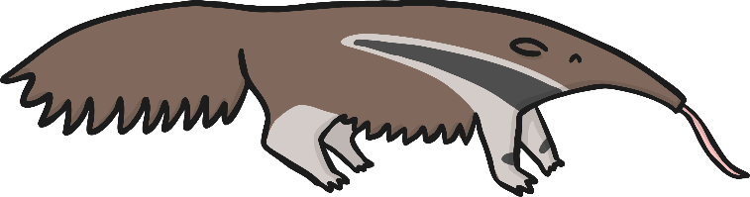
Rainforest Match
Match the animals to the correct rainforest layer.
emergent
canopy
understory
forest floor

