Slide 1
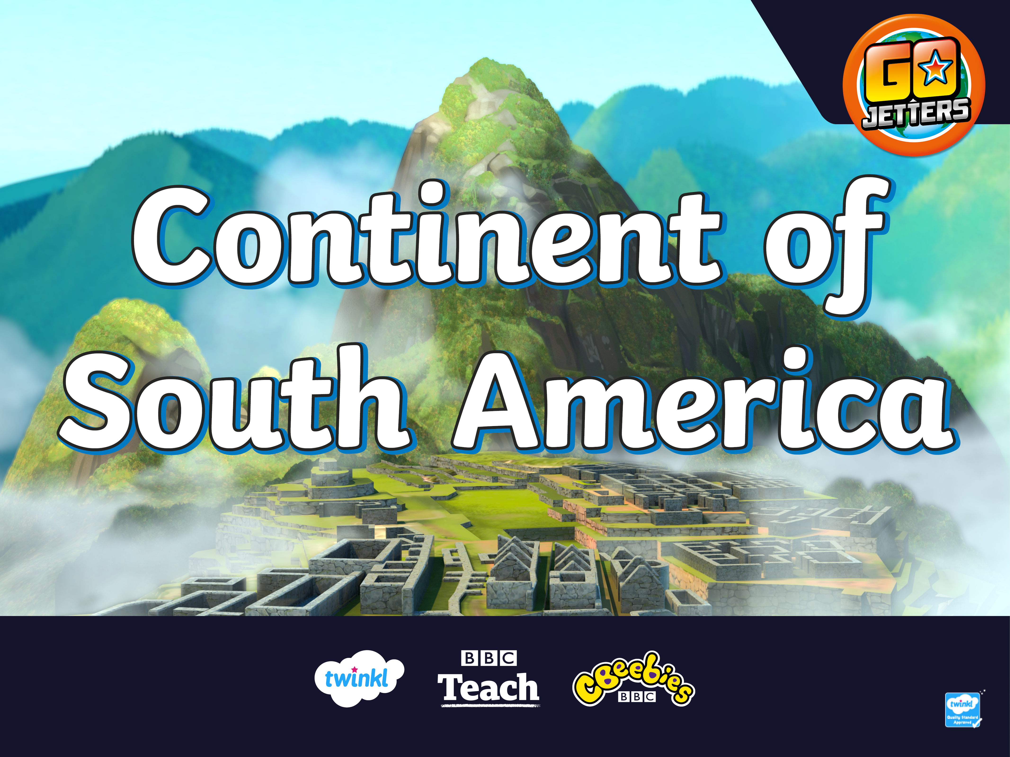

Slide 2
What Is a Continent?
There are seven continents on Planet Earth. A continent is a large area of land that is often separated from other areas of land by water or another feature such as mountains.
Which continent do you live in?
Europe
North America
Asia
Africa
South America
Oceania
Antarctica

Slide 3
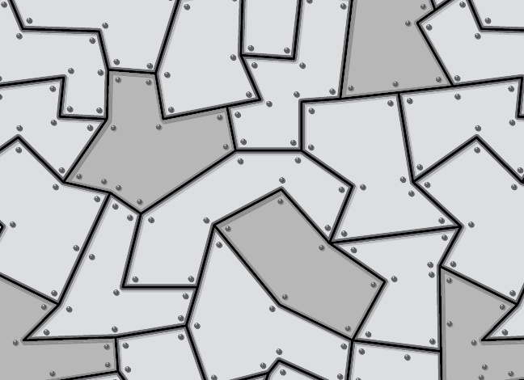
South America
Here is a map which shows the countries that are in the continent of South America.
South America is made up of twelve countries.

Slide 4
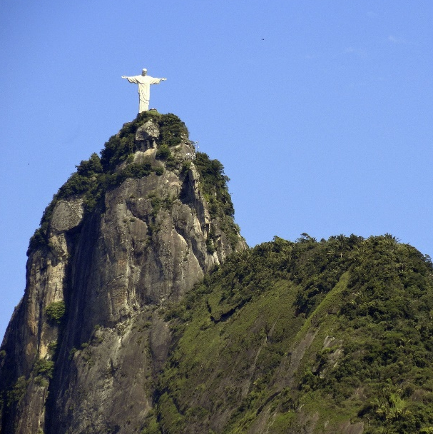
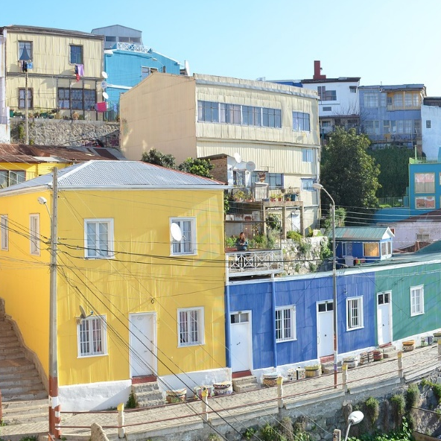
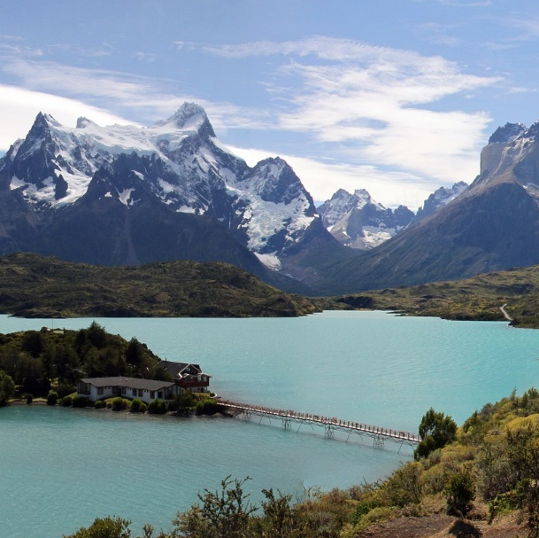
What Is South America?
Valparaiso
Christ the Redeemer Statue
Look at these pictures. Which are places from countries in South America and which are not?
Torres del Paine

Slide 5
What Is South America?
Valparaiso
is a city in Chile
Christ the Redeemer Statue
in Brazil
Did you work it out? They are all pictures of places in South America.
Torres del Paine
in Patagonia

Slide 6
What Is a Landmark?
Can you remember what a landmark is?
A landmark is something that stands out in an area. It could be a building, a bridge, a lake or river, a sculpture or something else. These places might be special because of their age or their size.
A landmark makes a place recognisable. This means you could look at a picture of a landmark and know straight away where it is.

Slide 7
What Is a Landmark?
Do you recognise any of these famous landmarks from around the world?

Slide 8
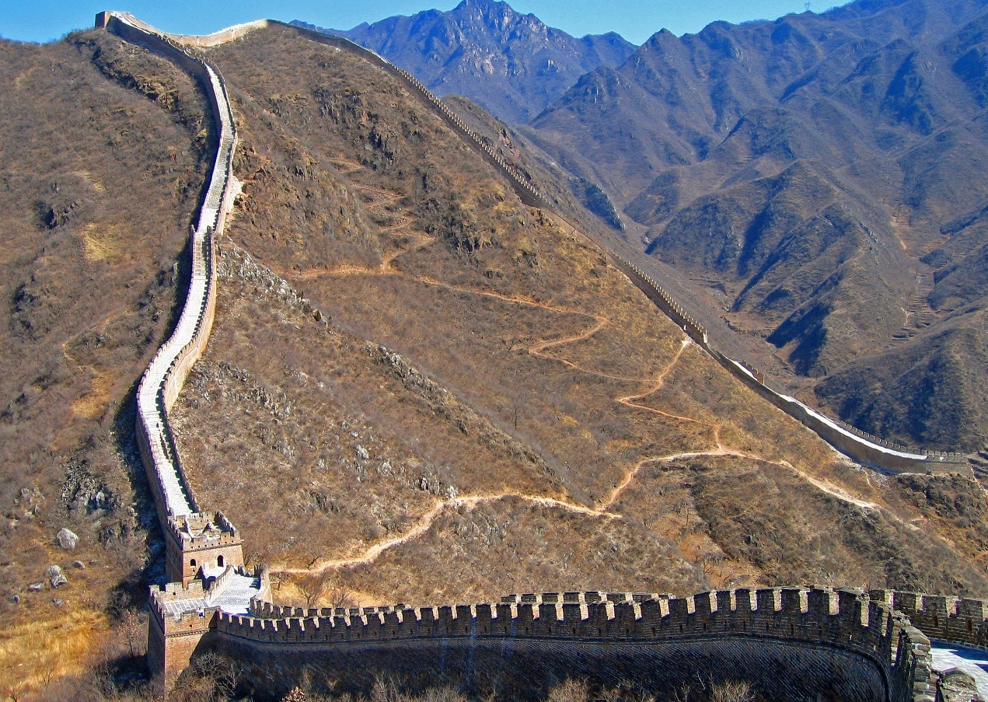
What Is a Landmark?
Great Wall of China, China

Slide 9
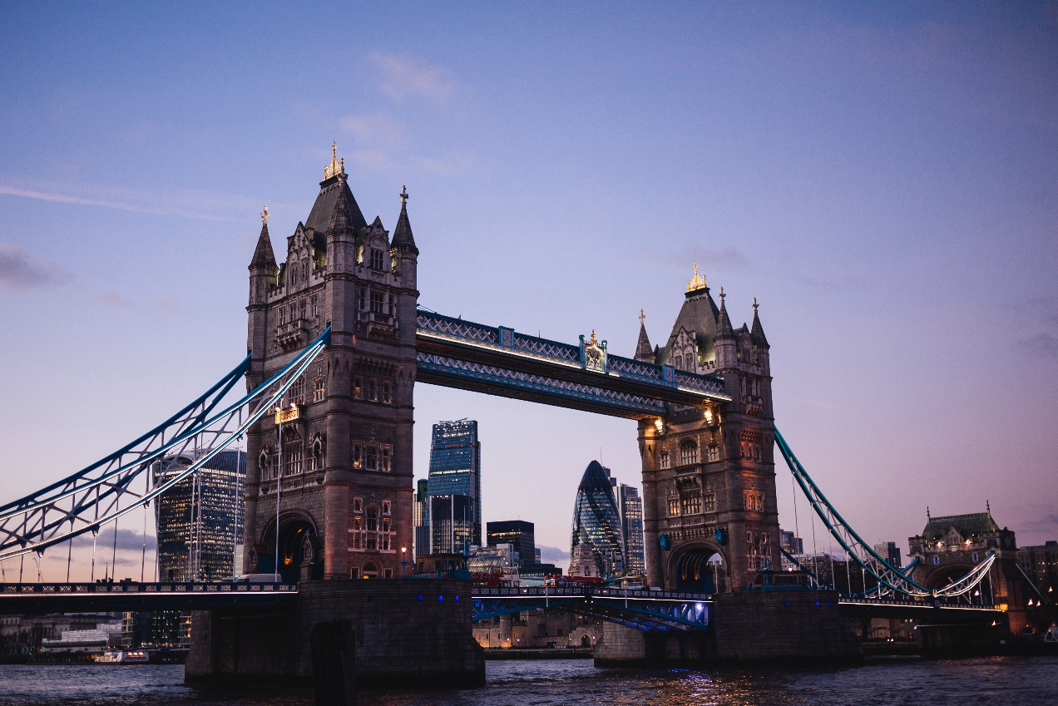
What Is a Landmark?
Tower Bridge, UK

Slide 10
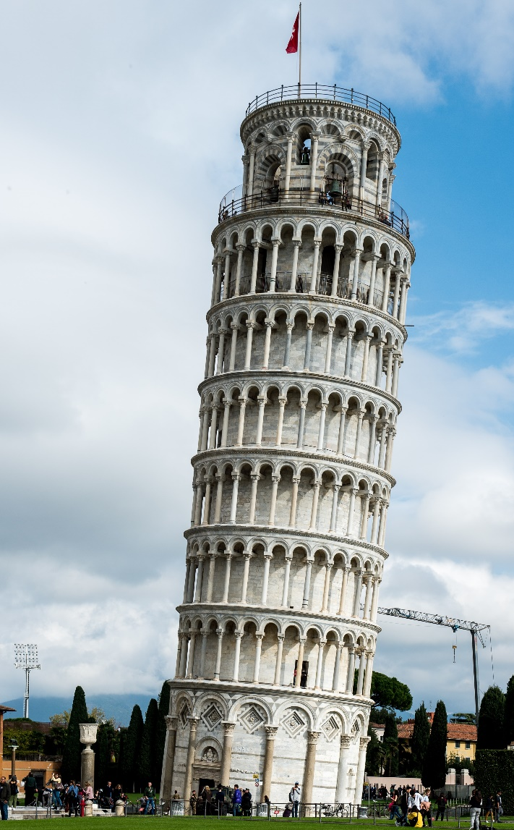
What Is a Landmark?
The Leaning Tower of Pisa, Italy

Slide 11
South America
Today, we are going to be learning about the continent of South America. Tell your partner anything you already know about South America.
Truckster! Let’s roll!

Slide 12
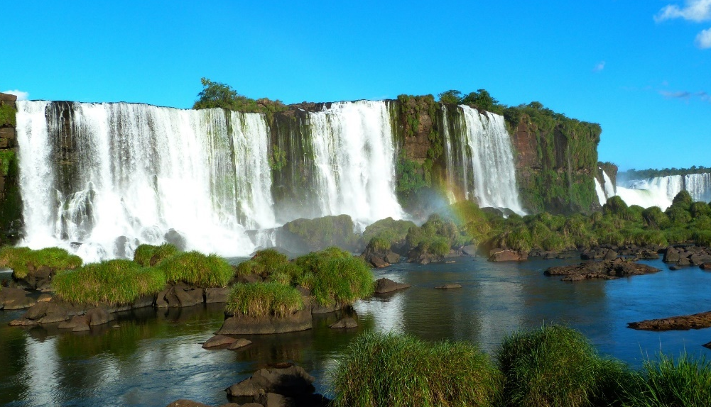
Iguazu Falls, Argentina
Iguazu Falls are at the borders of Argentina, Brazil and Paraguay. They are 82 metres high and almost 3000 metres wide. All the falls together make the biggest waterfalls in the world. Geographic!

Slide 13
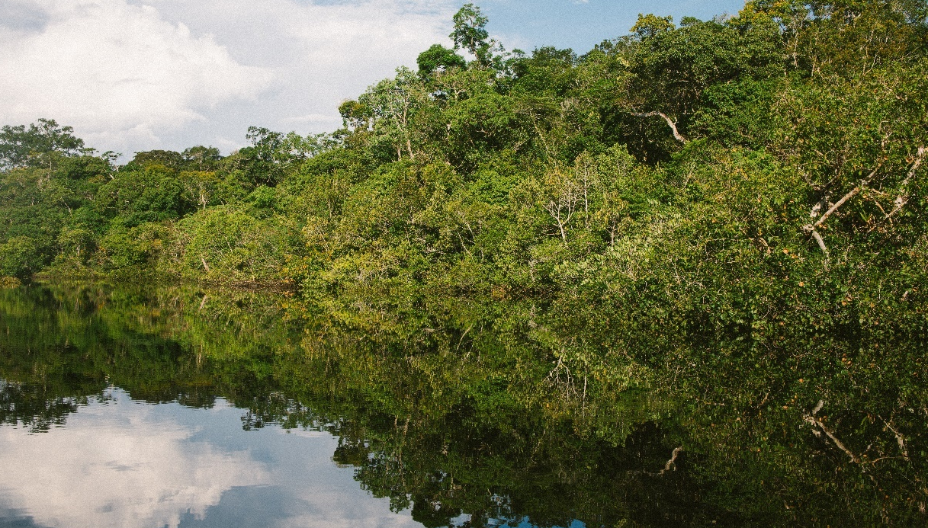
Amazon Rainforest
This is the Amazon rainforest which is in South America. Here is Ubercorn with some funky facts.

Slide 14
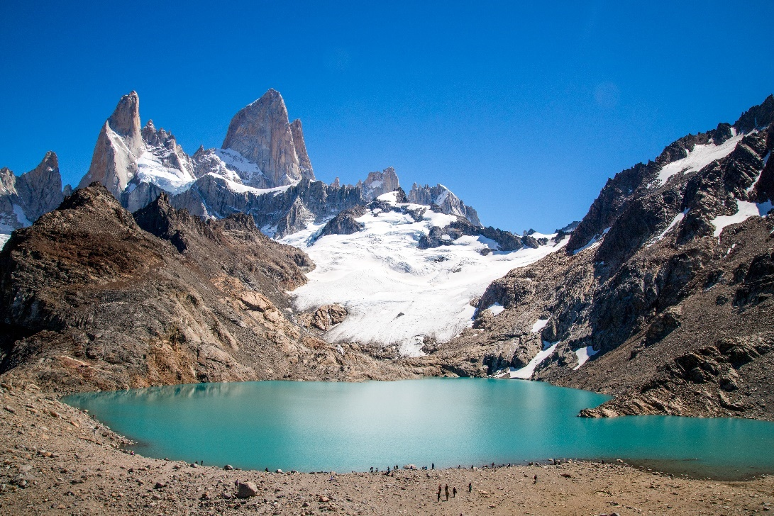
Mount Fitz Roy, Patagonia
Mount Fitz Roy is a mountain which is over 3300 metres high (which is about the same height as 736 double decker buses) and is one of the most difficult mountains to climb in the world!
Awesome! I would love to climb this mountain!

Slide 15
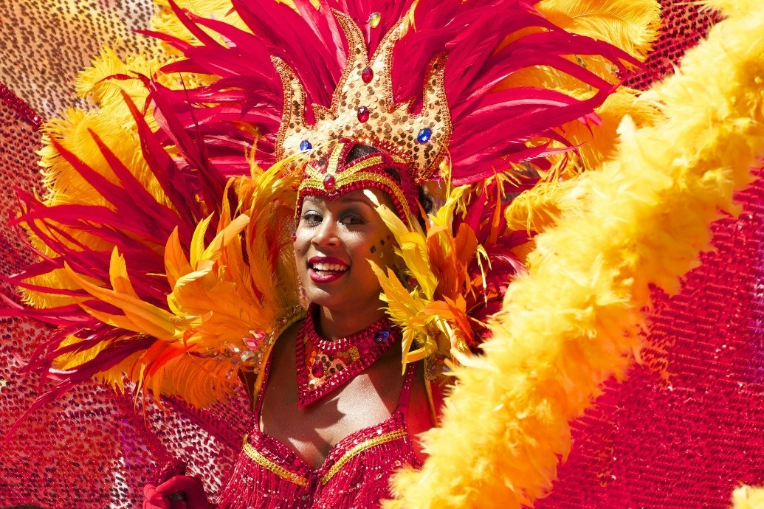
Rio Carnival, Brazil
Rio de Janeiro is a city in Brazil. It is famous for its carnivals. Here is Ubercorn to tell us more about it.

Slide 16
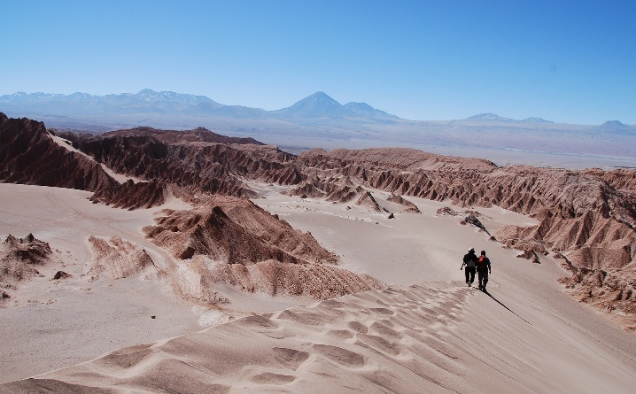
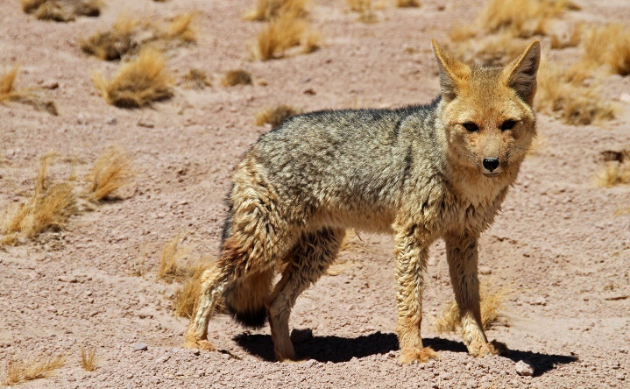
Atacama Desert, Chile
Here are some funky facts about the Atacama Desert.
3.
It stretches from Peru all the way to Chile.
2.
It has less than 1mm of rain a year and is the driest place on Earth.
Not many animals can live in such a dry place but some animals such as red scorpions, grey foxes, desert wasps and butterflies do.
1.

Slide 17
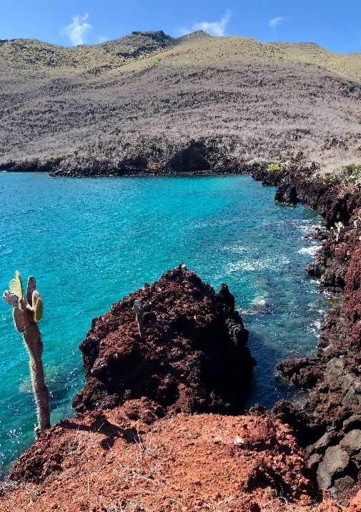
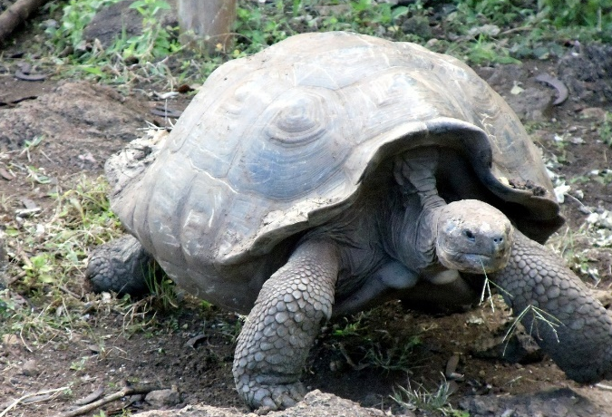
Galapagos Islands, Ecuador
The Galapagos Islands have been formed from volcanos. The islands are famous for having a wide range of animals and plants, many of which cannot be found anywhere else in the world, such as: the giant tortoise, land iguana, Galapagos fur-seal, Galapagos penguin and Galapagos hawk. Geographic!

Slide 18
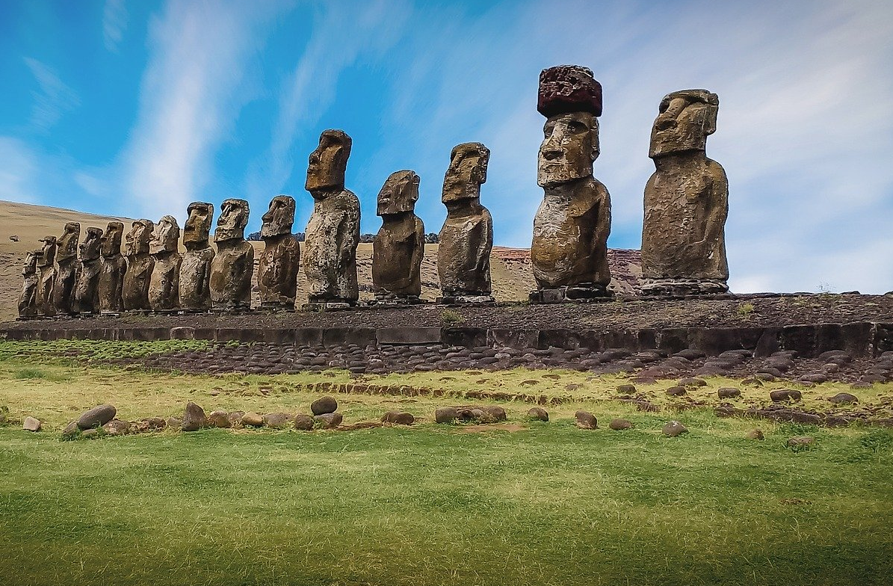
Easter Island
Easter Island is also called Rapa Nui. Let’s find out more from Ubercorn’s top three funky facts.

Slide 19
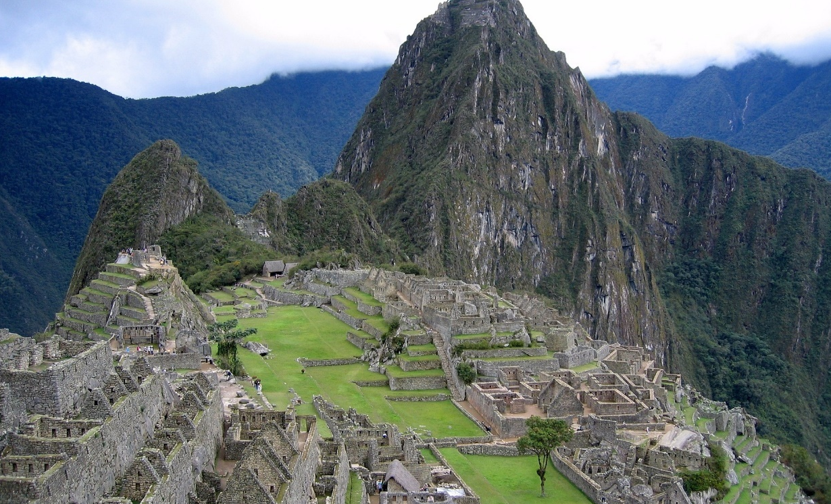
Machu Pichu, Peru
Machu Pichu is a city made of stone built in a tropical mountain forest in Peru. It was built for the Inca leaders around 600 years ago. There are 150 buildings altogether, from baths to temples. There is often low cloud around Machu Pichu because it is so high up!
I wonder how many stone steps there are here?

Slide 20
South America Quiz
How much have you learnt about South America?
It’s time to find out!

Slide 21
South America Quiz
1. What might you see at Easter Island?
a. a waterfall
b. stone statues
c. a desert
2. What might you see on the Galapagos Islands?
a. a giant tortoise
b. a kangaroo
c. a zebra

Slide 22
South America Quiz
3. What is Rio famous for?
a. a volcano
b. carnivals
c. a castle
4. Which animal lives in the Atacama Desert?
a. a cat
b. a horse
c. a grey fox

Slide 23
South America Quiz
5. What is Machu Pichu?
a. a bird
b. a river
c. a stone city

Slide 24
