Slide 1
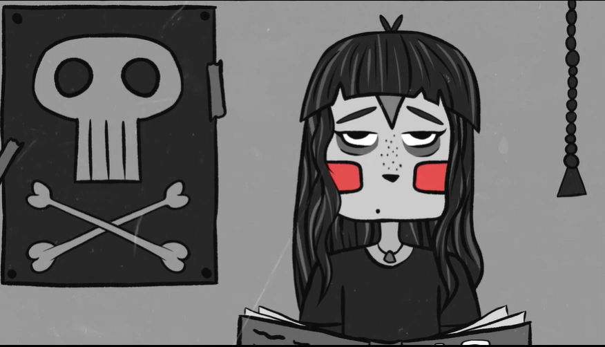
The Seven Ages of Man by William Shakespeare
Read by Thomas

