Slide 1
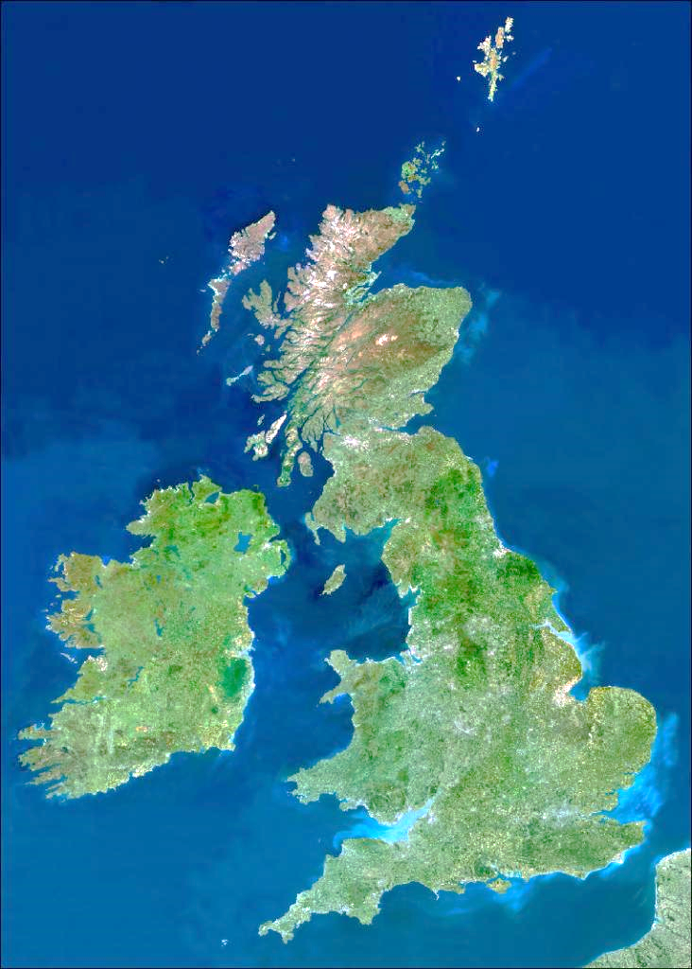
QUIZ- Satellite and Aerial pictures
Pretend you are a bird or a super hero flying above the land.
Can you recognise the shapes of land or local landmarks that are located near where we live?
?

Slide 2
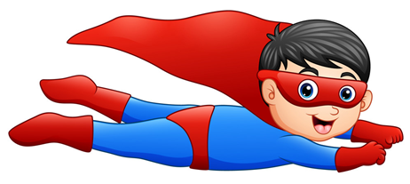
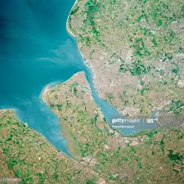
Recognise this
peninsula?

Slide 3
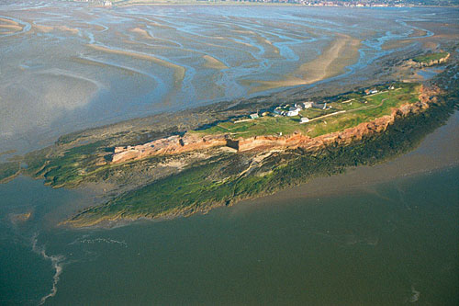
Clue: Off the coast at
West Kirby

Slide 4
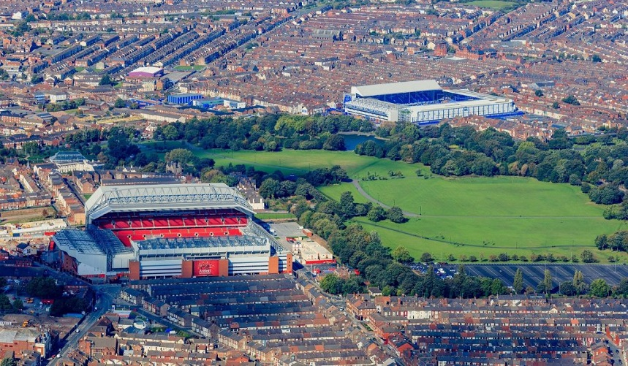
Clue: Across the River Mersey

Slide 5
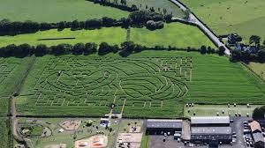
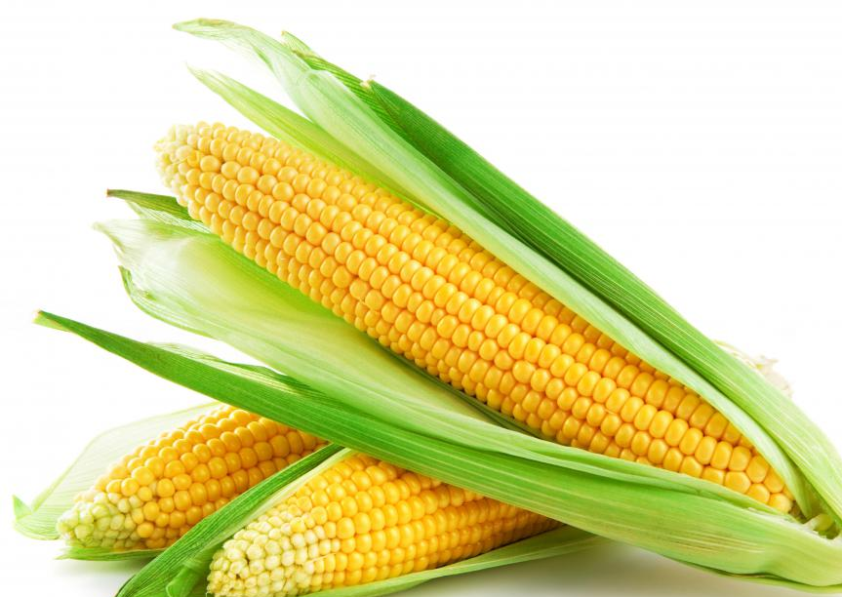
Clue:

Slide 6
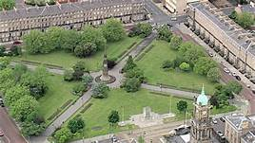
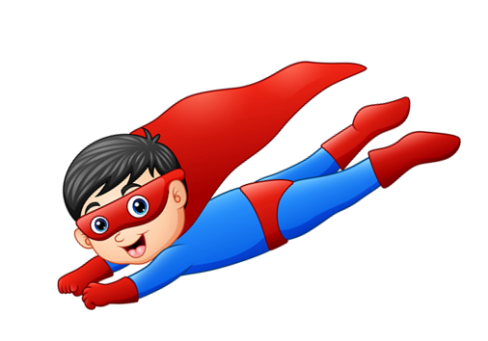
Clue: In Birkenhead

Slide 7
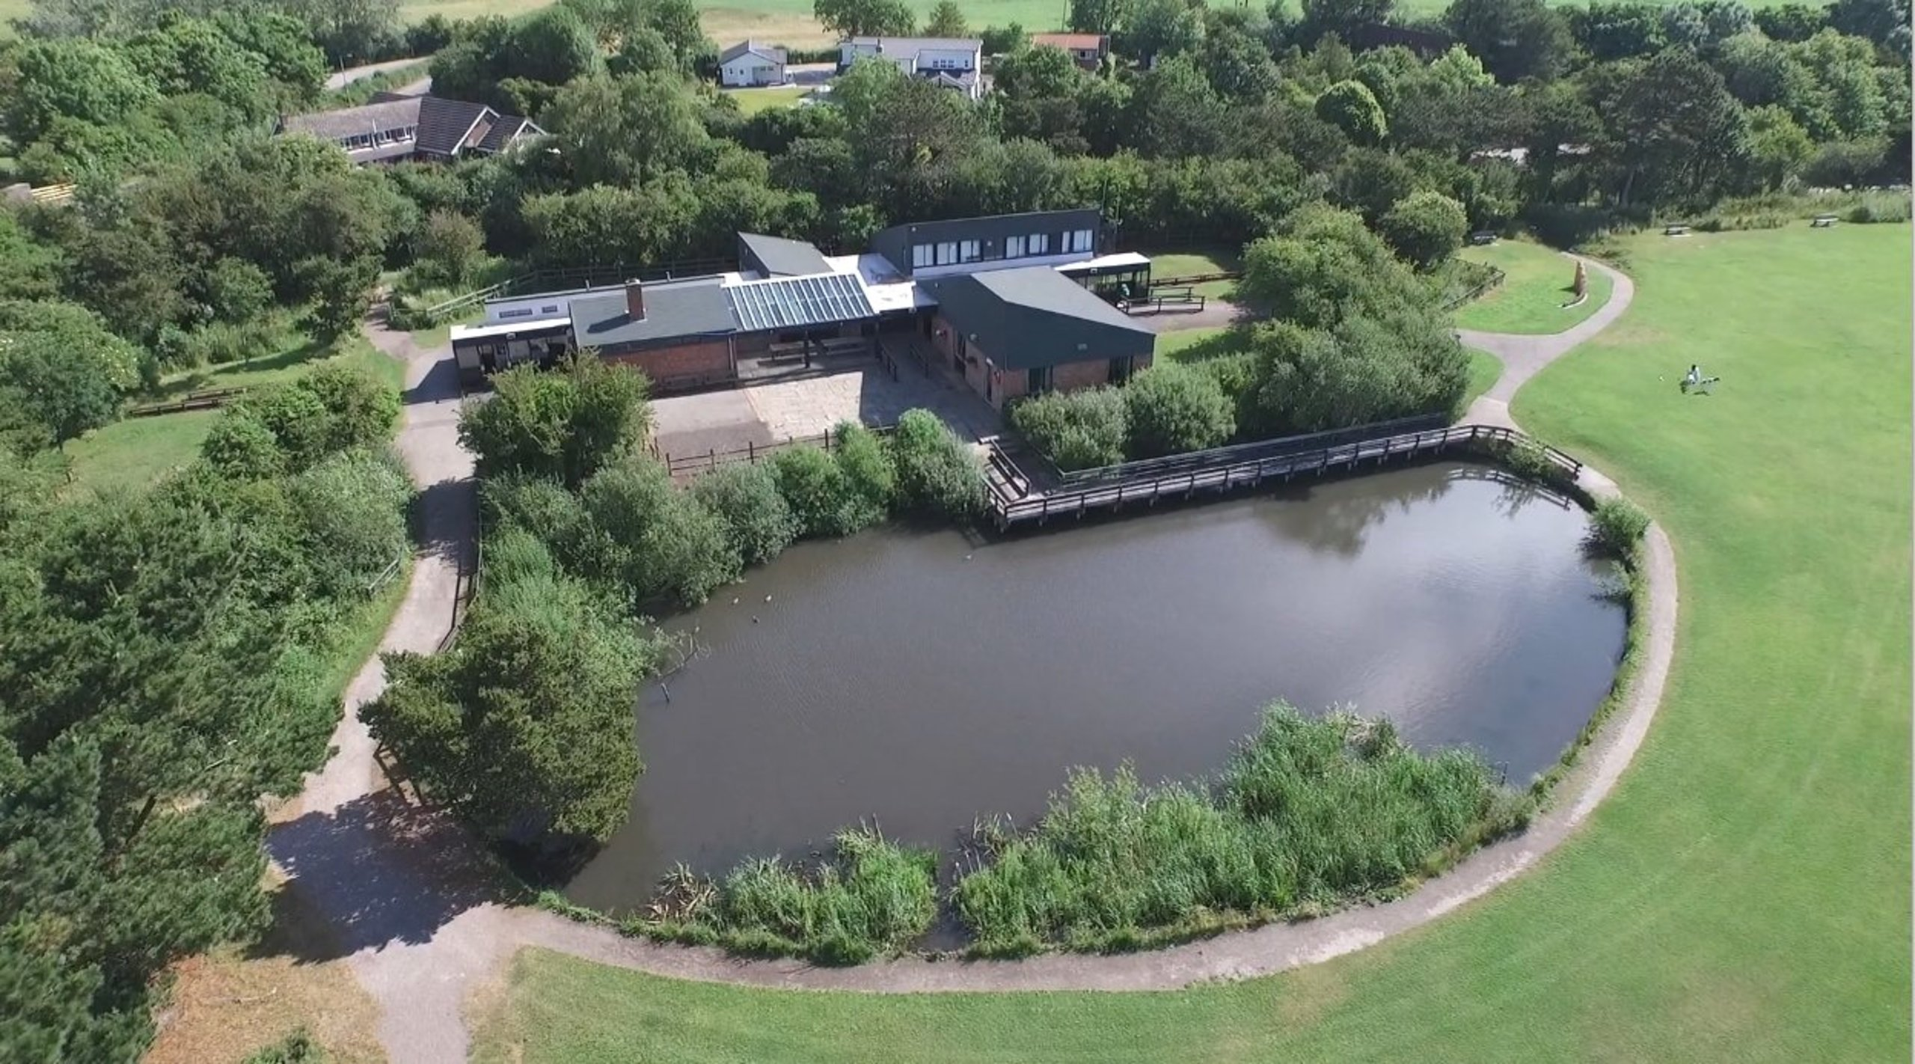
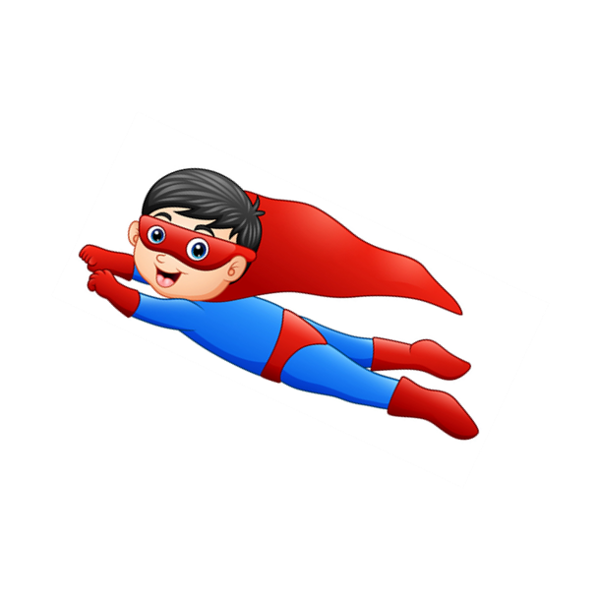
Clue: Lots of wildlife. Near cliffs and below there is a beach.

Slide 8
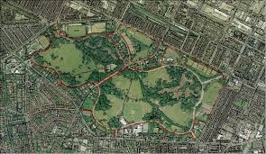
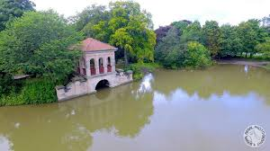
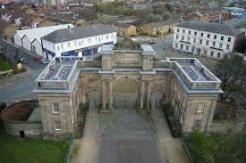
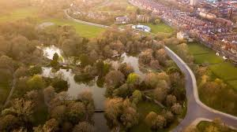
Clue: Joseph Paxton

Slide 9
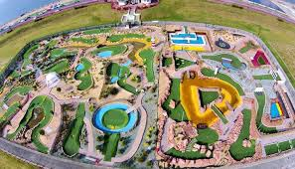
Clue: Near the beach

Slide 10
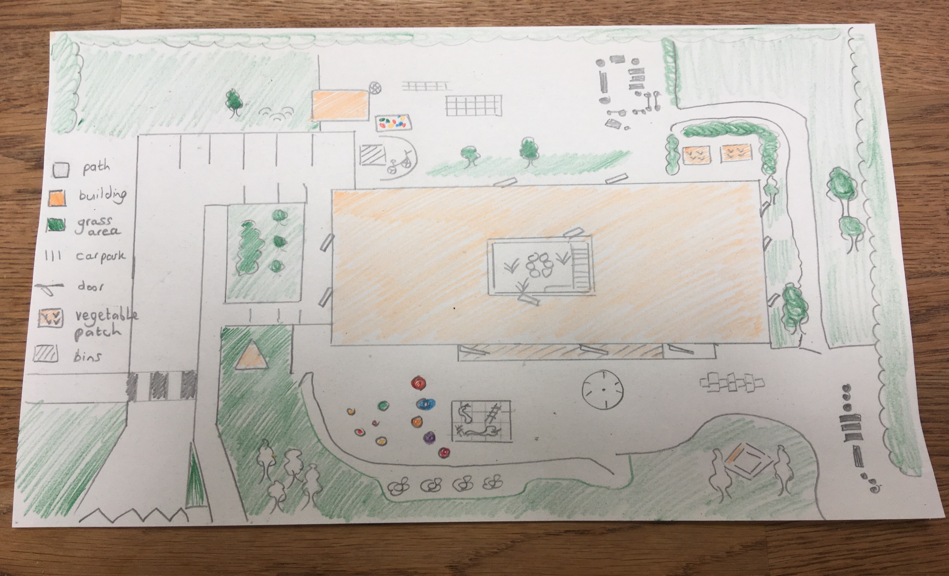
My aerial plan of school
Key

Slide 11
Can you be like us and pretend to
hover over your garden or bedroom?
Draw a plan of what it might look like from above. (aerial)
Use a key to let us know what certain shapes or colours mean.

