Slide 1
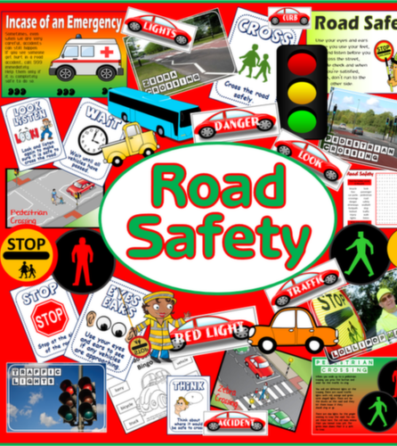
ROAD SAFETY QUIZ FOR YEARS 5&6
Test your knowledge!

Slide 2
School crossing patrols have the same powers as police to stop traffic... True or False
A) True
B) False
Bonus point
Write down why you should ALWAYS cross with the school crossing patrol.

Slide 3
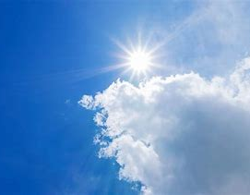
Which one of the following helps you to be seen when walking or cycling during the daytime..
A) Something dark
B) Something reflective
C) Something fluorescent

Slide 4
Write the stages of the Green Cross Code in order of what you must do first
1
2
2
4

Slide 7
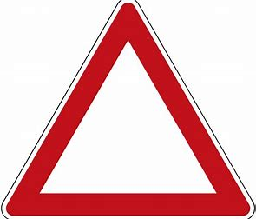
What do triangle shaped road signs do?
A) Give orders
B) Give warnings
C) Give information
Have a look on your way home, see how many you know the meaning of.

Slide 8
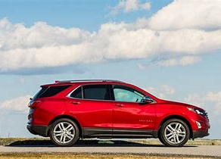
"A driver can be fined up to £500 if a child under 14 isn’t in the correct car seat, or wearing a seat belt while you’re driving"
True or false!
A) True
B) False
Bonus Point:
Why is it important?

Slide 9
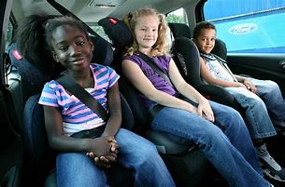
Write down by number the things you must NOT do when you are a passenger in a vehicle
1. Refuse to sit in an age appropriate car seat
2. Lean out of the window
3. Block the driver’s view in the mirror
4. Talk loudly and shout
5. Throw things out of the vehicle
6. Behave sensibly and respect the driver
7. Open the car door
8. Unbuckle your seatbelt

Slide 10
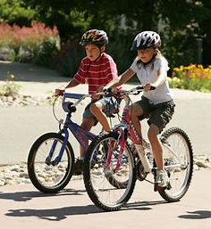
What does it mean when a cyclist puts out their right arm and moves it up and down?
A) I’m turning right
B) I’m losing my balance
C) I am slowing down or stopping

Slide 11
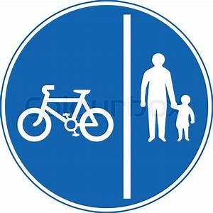
What does this sign mean?
A) No cyclists or pedestrians allowed
B) Route for cyclists and pedestrians
C) Only children who can ride a bike allowed

Slide 12
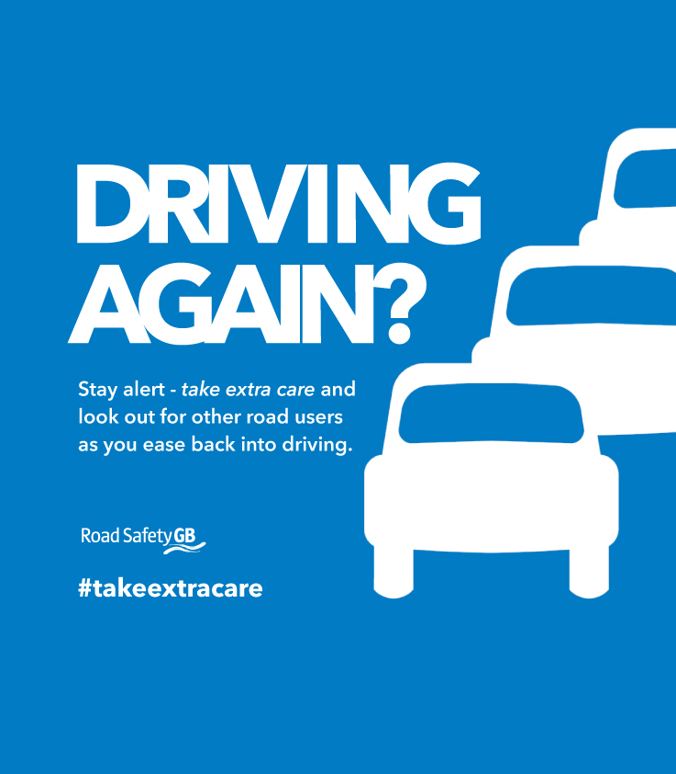
This poster asks drivers to look out for other road users
Write down as many different road users as you can think of in 1 minute
Bonus point, why are drivers being asked to take extra care?

Slide 13
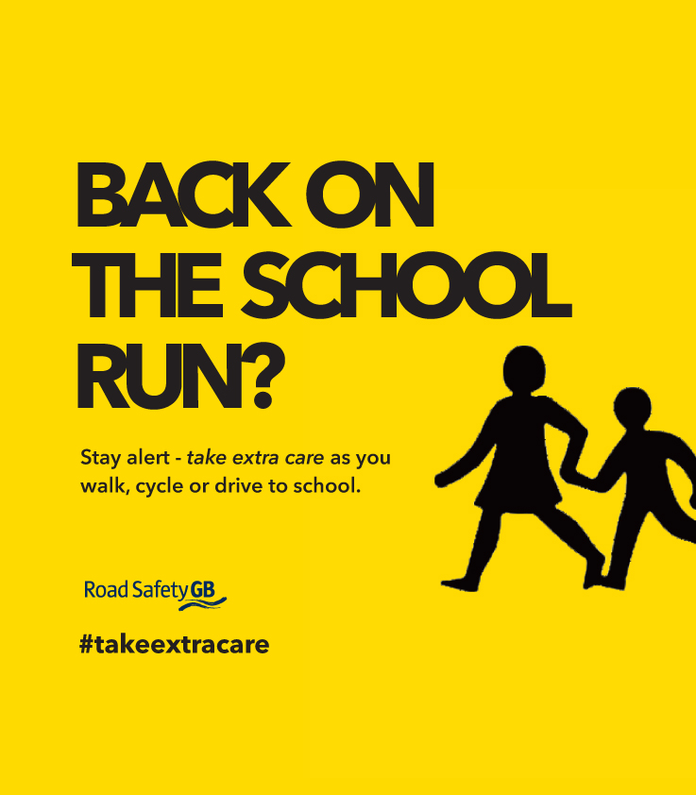
CHOOSE AND DESIGN YOUR OWN ROAD SAFETY MESSAGE ON A SHEET OF A4 PAPER

