Slide 1
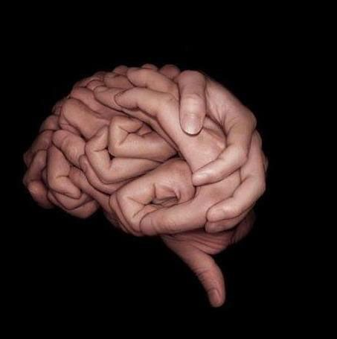
Art can tell a thousand stories without even writing or speaking a word. Photographs, drawings, paintings, sculptures can all send messages to our brain. Our brain then make us think about what we see. Sometimes we see things that others can. Sometimes we see things that others don’t see. This is good too. Our imagination makes us think different things.
What do you see in this photograph?

Slide 2
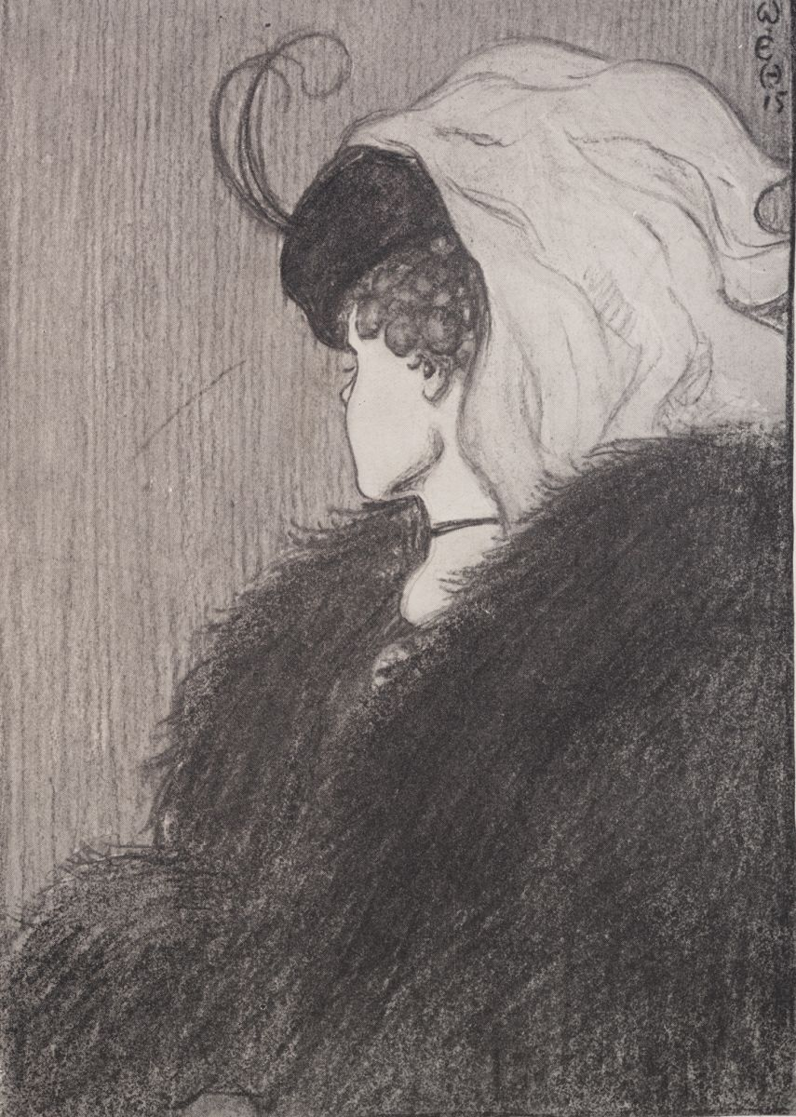
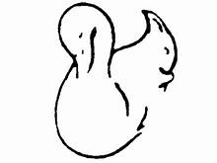
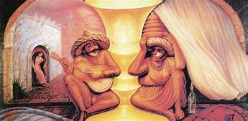
Look carefully at the pictures. Can you see different things? What do people in your family see? These pictures give an ‘optical illusion’- it can show at least two different pictures.
What does your brain tell you to see here?
Swan or squirrel? Two old people, people sitting down, a candlestick? What do you see here?

Slide 3
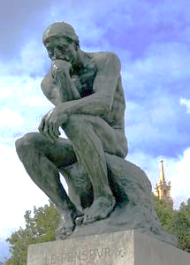
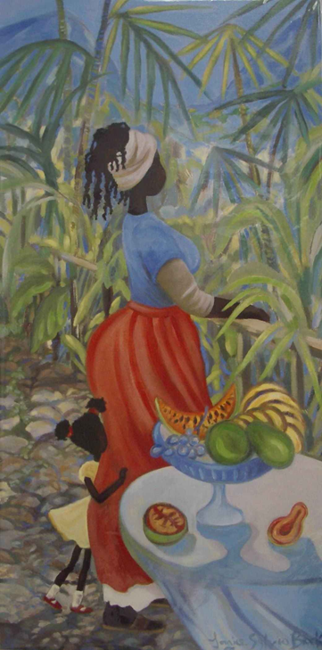
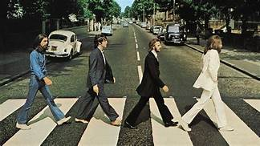
Art work does not always play tricks on your brain but it does allow you to think different things about it.
Look at these art forms. What do you think they are about? Do they have a story? What are they telling you? Have you seen any of these pieces before?
Talk with someone else. What do they think?

Slide 4
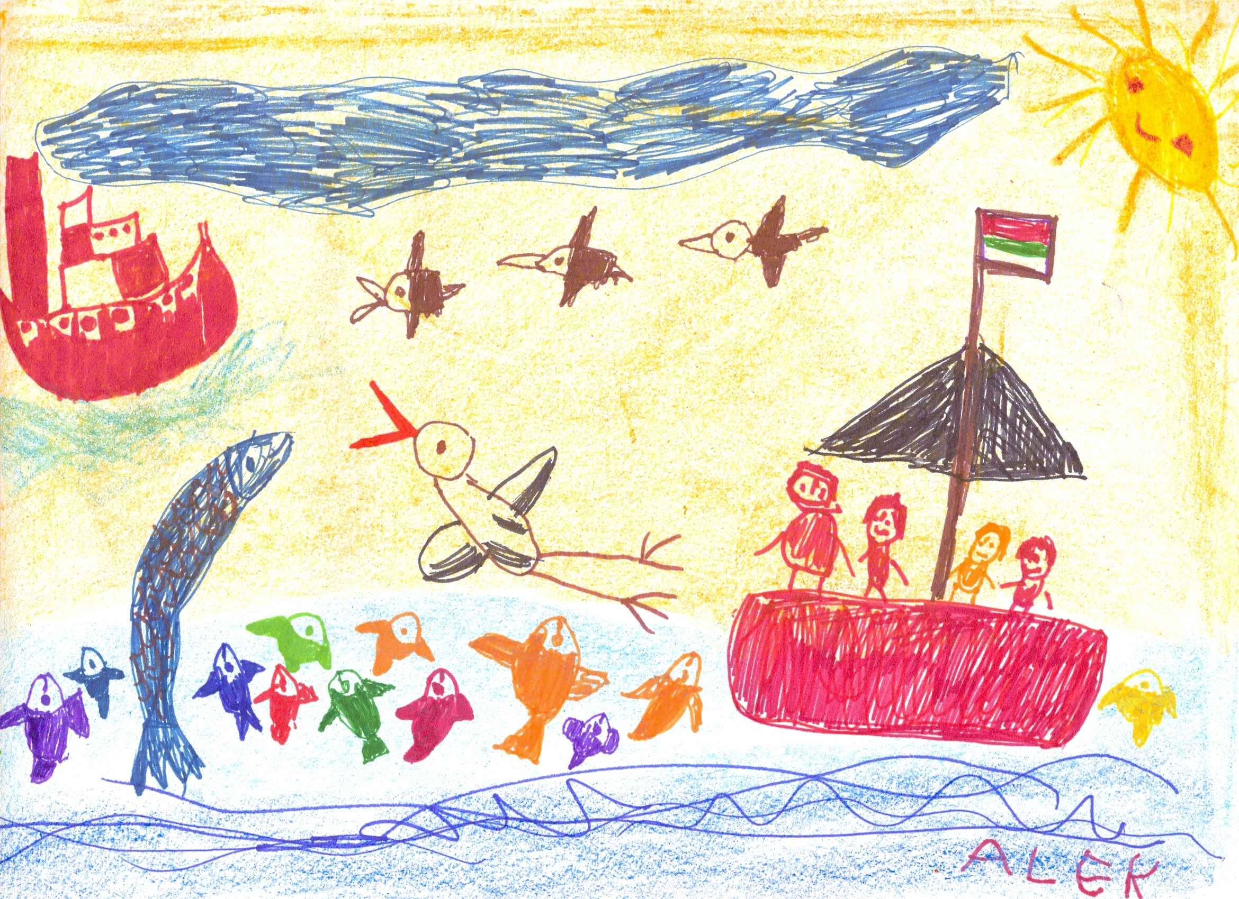
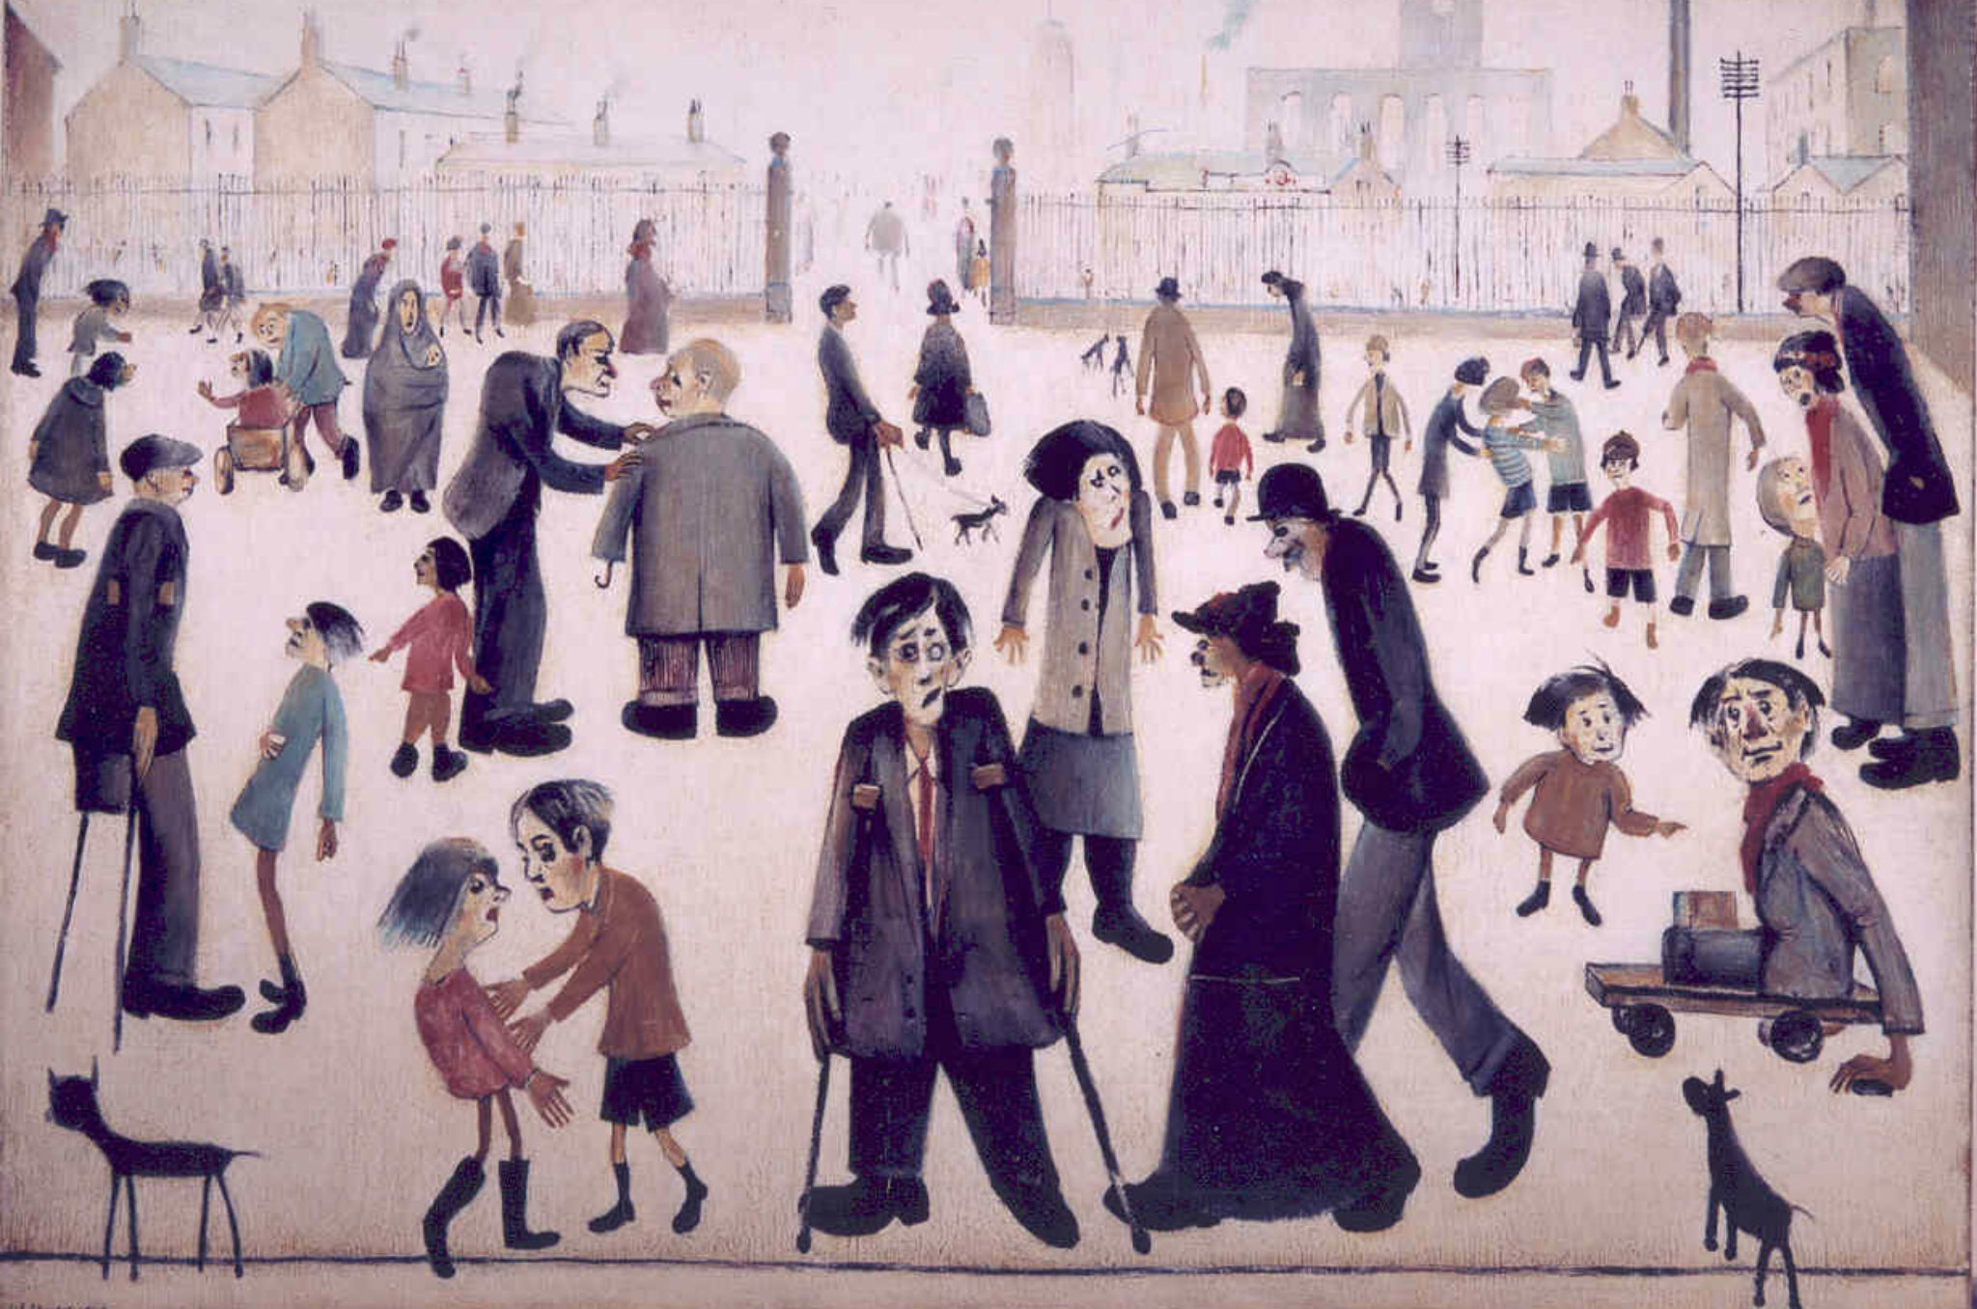
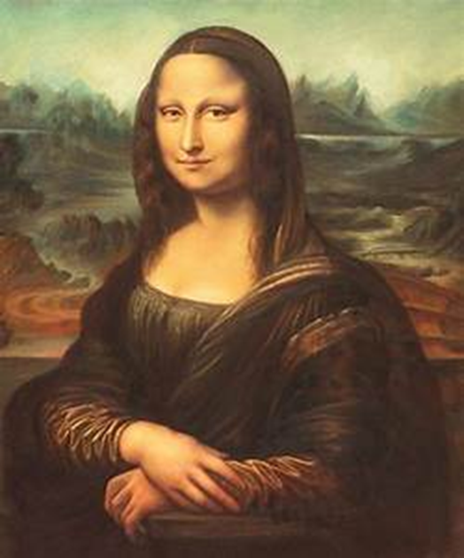
What do these tell you?

Slide 5
What do you think this painting is saying to you?
By Banksy

Slide 6
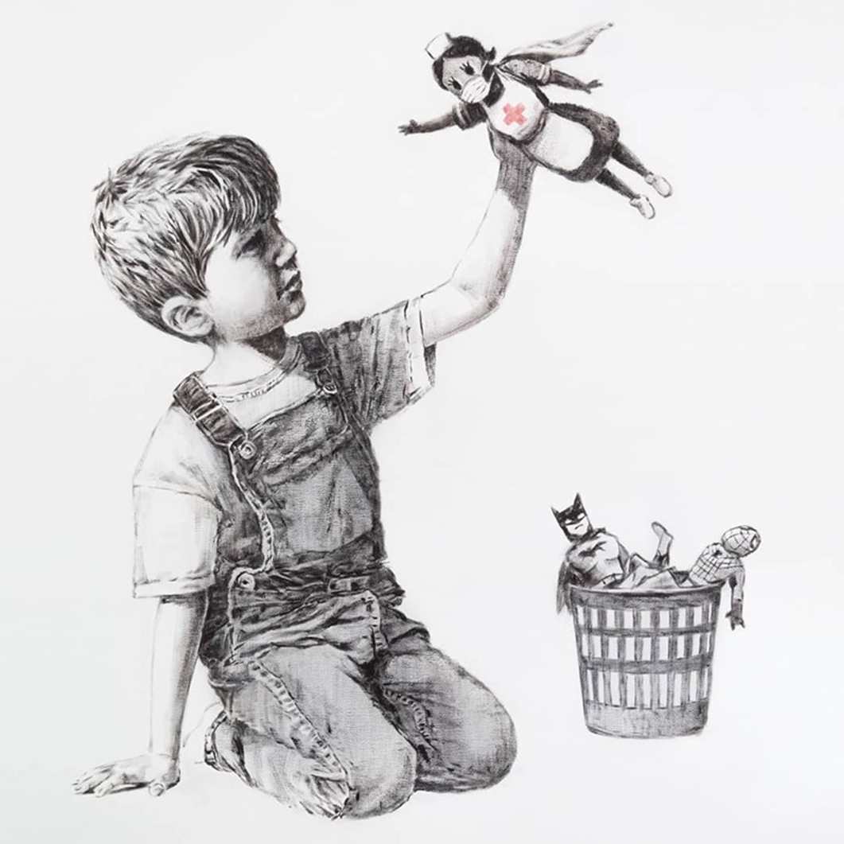
Banksy is a mysterious artist that has not been seen in public so people do not know what he looks like , yet his work is famous worldwide. He secretly paints his work mainly on the side of buildings or even on the sides of lorries when no one else is around. His work suddenly appears on view in random places. This piece was given to Southhampton Hospital to thank the staff looking after people. See the link below. -
https://uk.video.search.yahoo.com/search/video?fr=mcafee&p=banksy+nhs#id=55&vid=1a1be6828e69e36b2c80bde472c4d57e&action=view

Slide 7
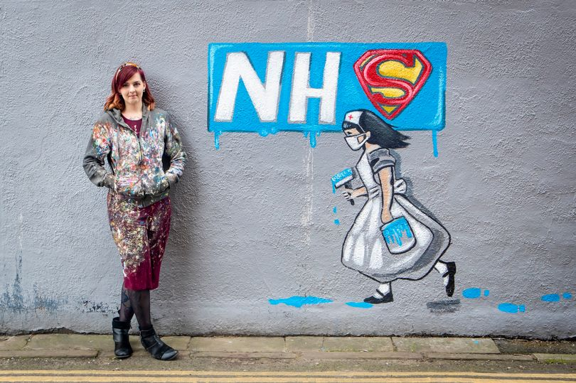
Rachel List from Yorkshire
has painted a series of murals on
buildings recently.
What do you think she is trying to
say in this mural?

Slide 8
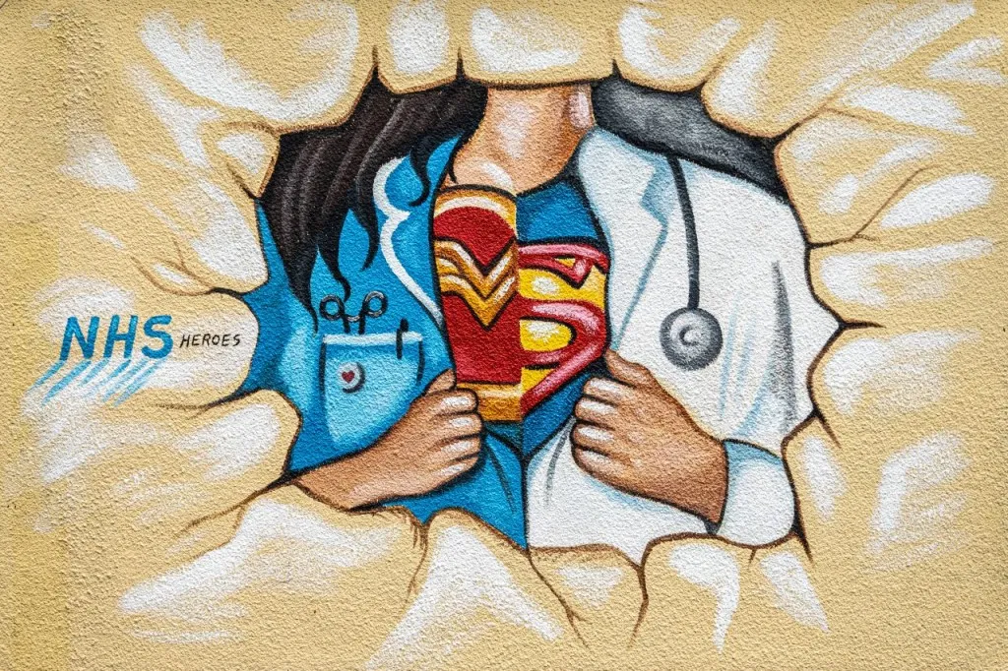
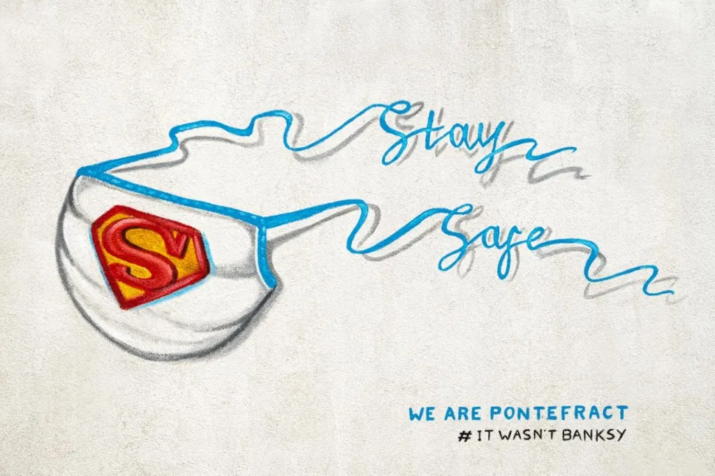
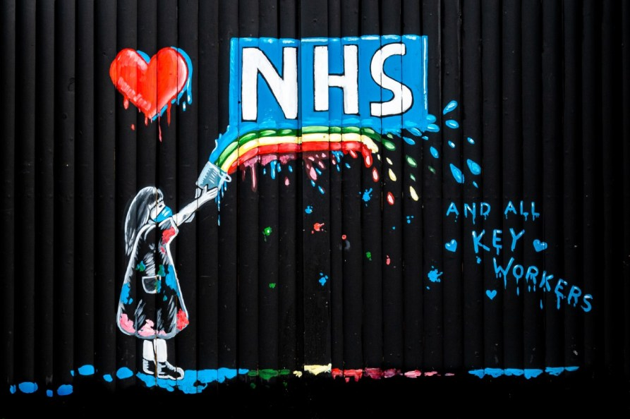
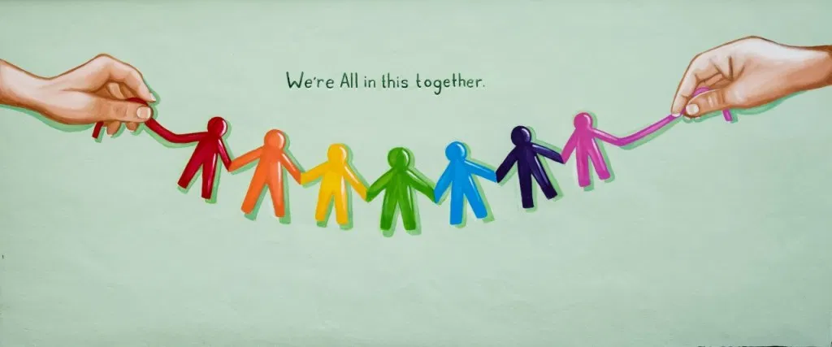
More of Rachel List’s work.
What do you think about these?

Slide 9
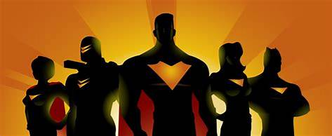
The National Health Service Workers (NHS) have all been brave and risked there own lives during COVID-19.
Many others have been brave and saved lives too.
People such as ……
They have worked like heroes saving lives and keeping people safe- they have become our own super heroes.
..the Police, shop keepers, delivery drivers, Mums, Dads, neighbours.
Can we transform these people into super heroes too like Banksy and Rachel List transformed the NHS with their artistic ideas?

Slide 10
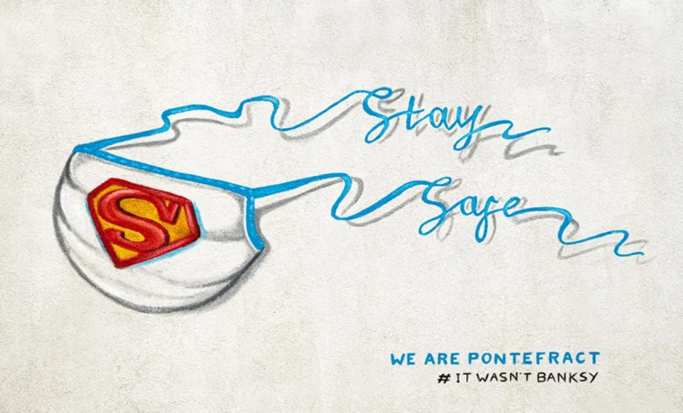
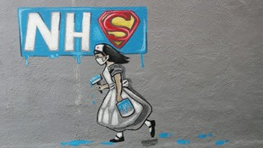
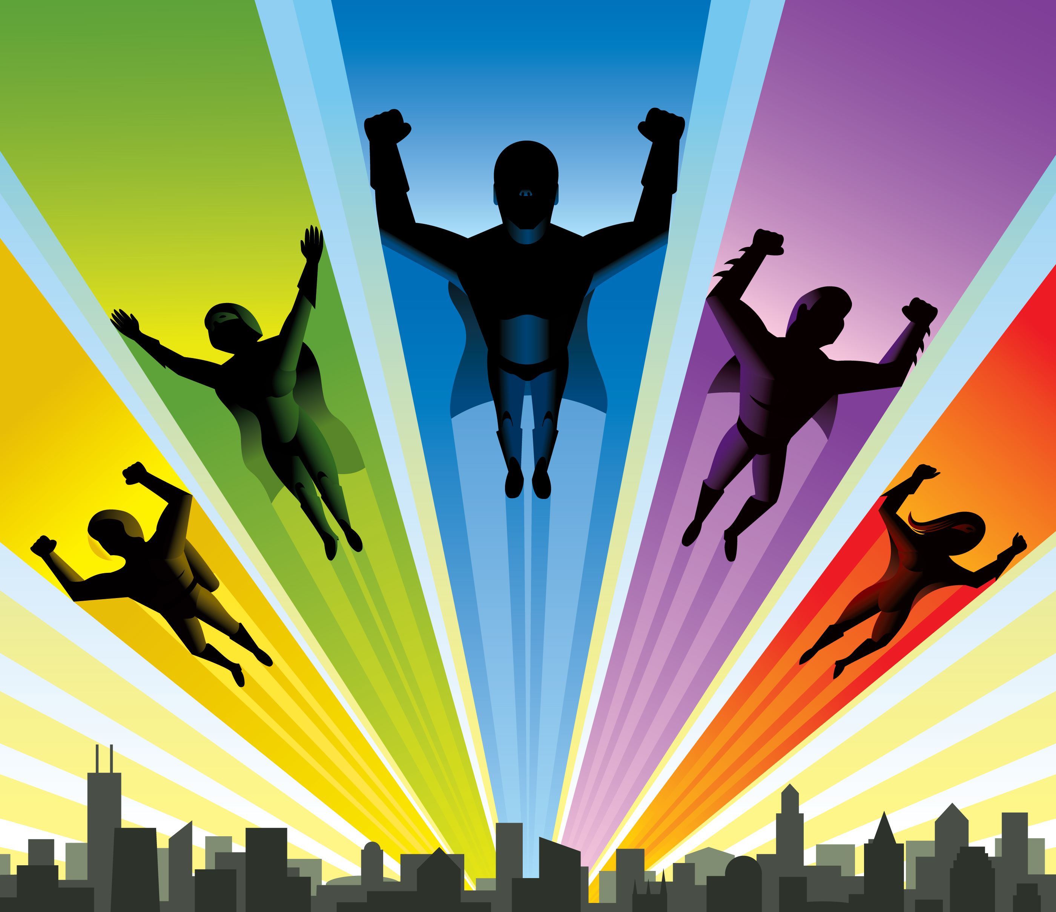
?
Who will you draw and turn into a superhero?

