Slide 2
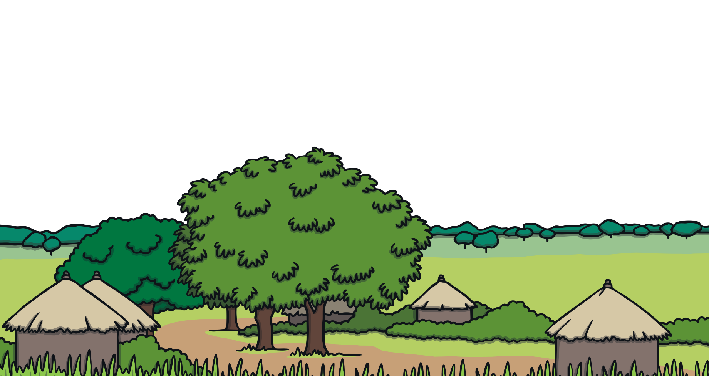
Writing a Diary Entry
When you write a diary entry, you are writing about a day in the life of a real person or character.
Imagine that you are someone who is trying to help their village. You are going to write a diary entry to recount the events of the day when you tried to help.
Let’s find out more about the key features of diaries that you will need to include in your writing.

Slide 3
‘I’, ‘My’, ‘We’ and ‘Our’
These words are special because they tell us the diary is being written by someone and they are talking about themselves.
Look at these two examples. Which one do you think was written by the person who was doing the action?
I ran home as fast as I could. My family were all dancing and cheering. We celebrated with our neighbours.
She watched the clouds roll across the sky. When she got home, they decided to celebrate with music and dancing.

Slide 4
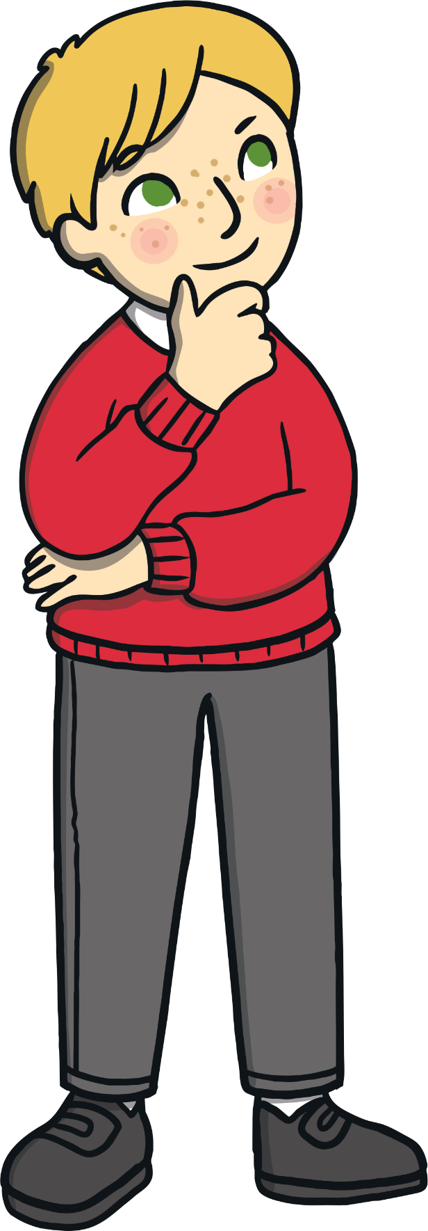
Putting the Events in Order
When you write a diary entry, you are retelling events that happened to someone who wasn’t there or you are making sure that you can remember them carefully in many years to come.
Why do you think that it is important to make sure that you write about events in the order that they happened?
What could happen if you put the events in the wrong order?

Slide 5
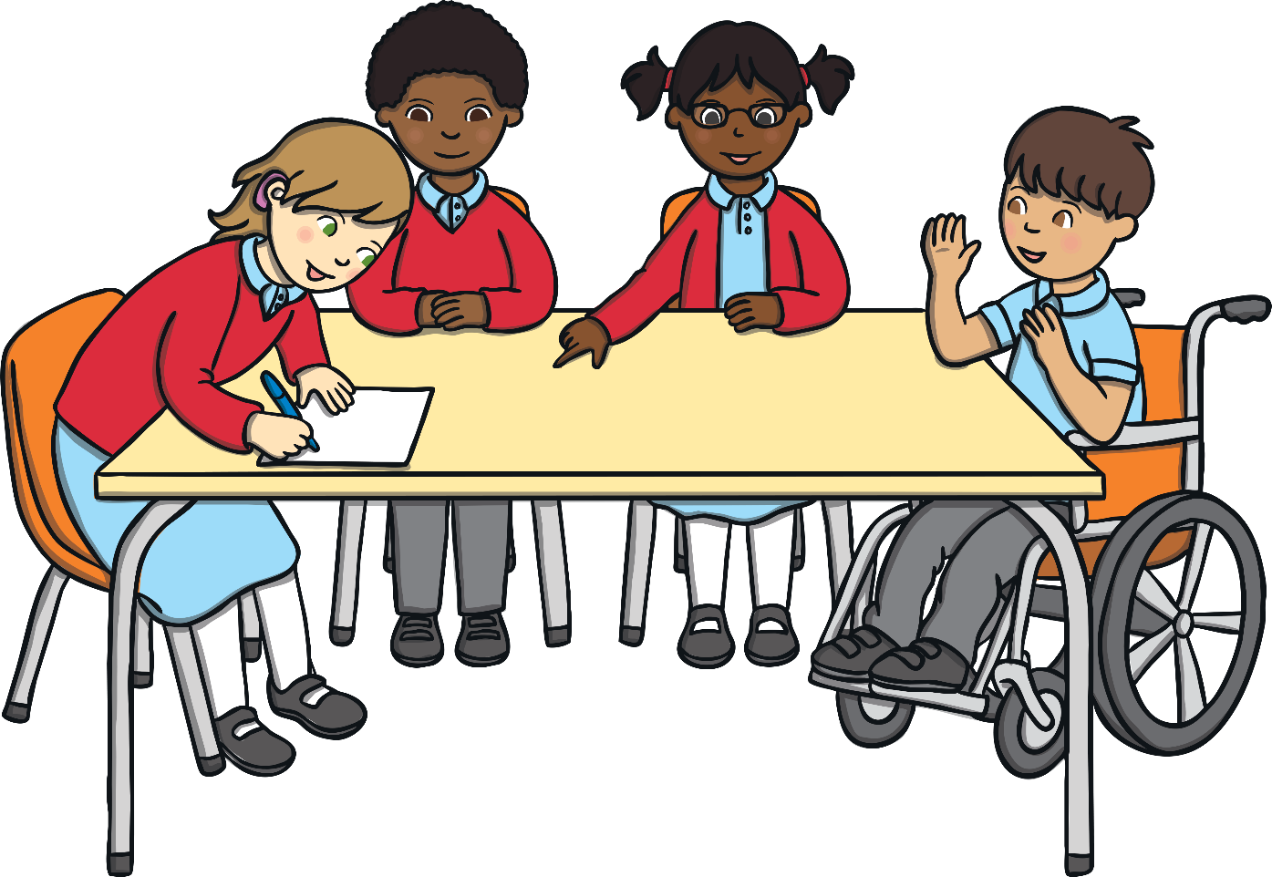
Putting the Events in Order
Can you order the things you did before school this morning?
Tell your partner the events in the correct order.

Slide 6
Using Time Linking Words
To make sure that the events are in the correct order, it is helpful to include time linking words. You might want to use ‘first’, ‘next’ or ‘then’.
Look at the events below. Can you think of different time linking words that the writer could use at the start of each sentence to show the order that the events happened in?
I felt a cool breeze and the dust began to dance.
I saw the clouds roll in and the sky turned grey.
I heard a loud crash of thunder and I saw a flash of lightning.
First,
Then,
Next,

Slide 7
Describing Your Feelings
In a diary, you might include feelings, hopes or fears that you wouldn’t want anyone to know about.
Look at the example below. Where has this diary writer described their feelings?
Dear Diary,
As I sat on a rock on the mountaintop, . The sun was still shining and . ?
I felt disheartened and upset
I worried that the rain would never arrive
What would we eat if the crops failed
answers

Slide 8
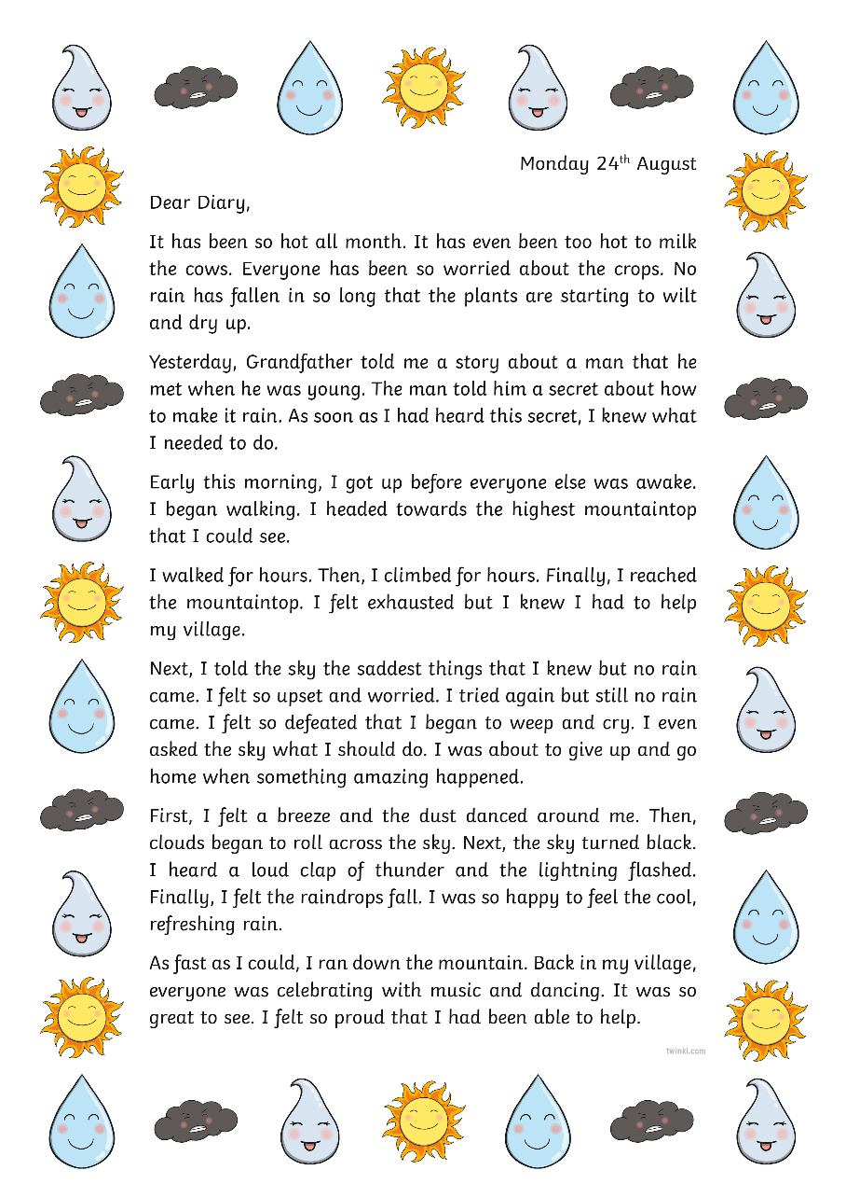
What do you need to include in a diary entry?
Take a look at this example to give you some ideas.

Slide 9
Add a date.
Talk about yourself using ‘I’ and ‘me’.
Write as if you were there at the time.
Use time linking words.
Write the most important events in the correct order.
Talk about where the events happened.
Describe how you felt.

Slide 10
Diary Writing Checklist
Can you remember all of the things that you need to include in a diary entry?
A diary should include…
Use this checklist to help you to write your own diary entry.

